Slide 1


Slide 2
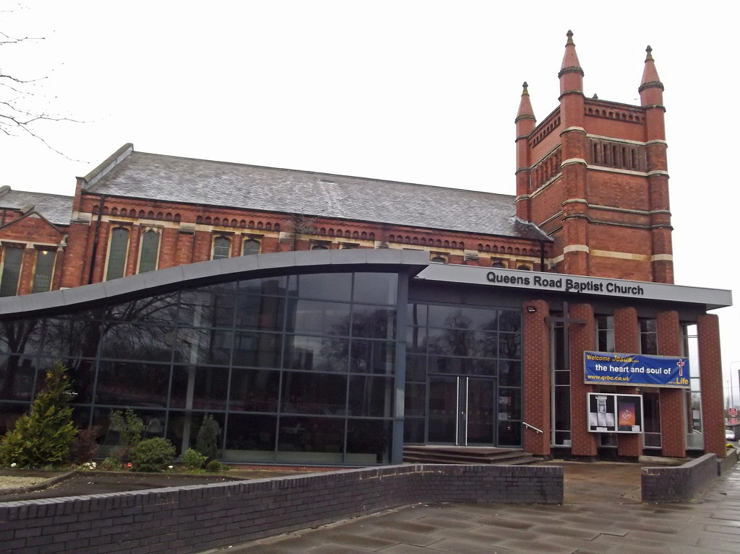
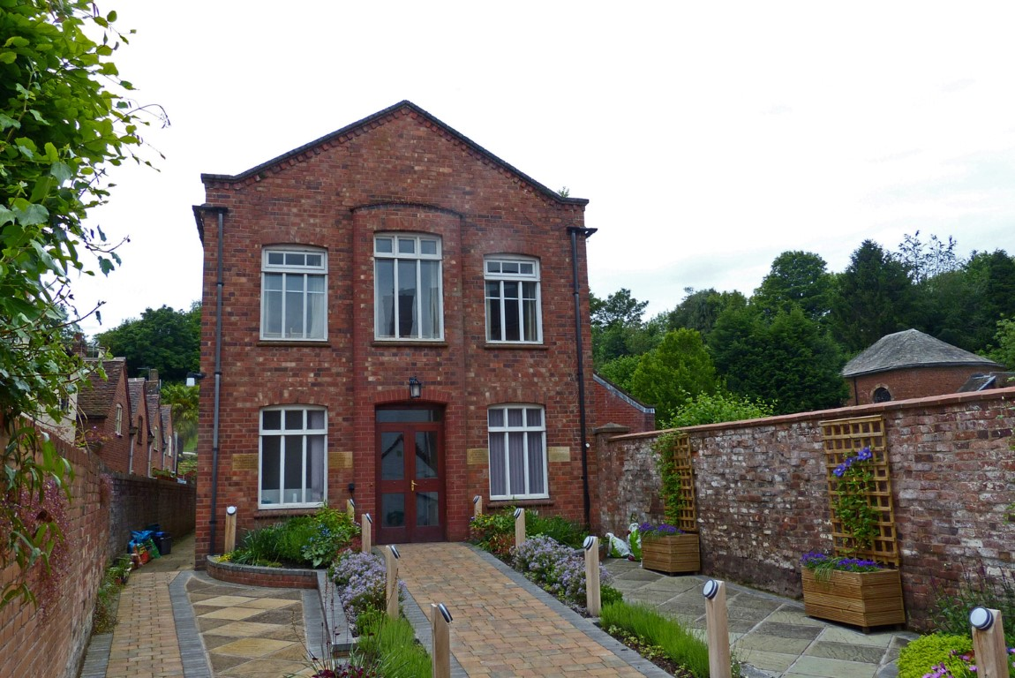
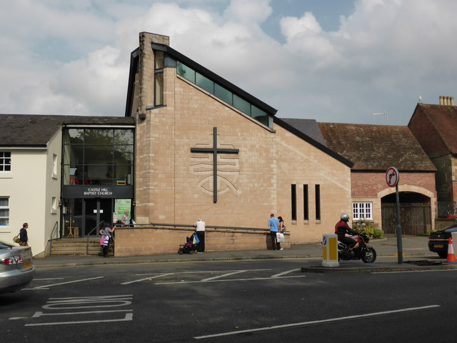
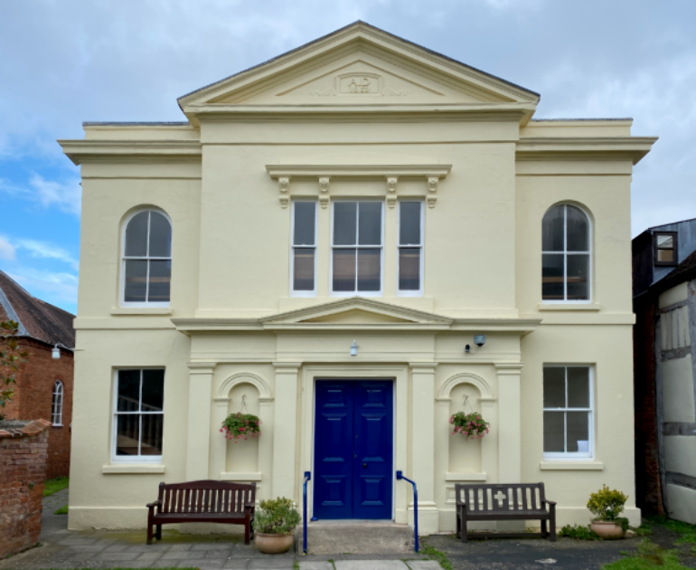
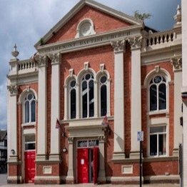
Pre 1650
Churches
Bewdley
Coventry
Warwick
Shrewsbury
Alcester

Slide 3
Bridgnorth
Bromsgrove
Worcester
1650-1700
Far Forest
Pershore
Henley-in-Arden
Upton-on-Severn

Slide 4
Bridgnorth
Bromsgrove
Worcester
1650-1700
Far Forest
Pershore
Henley-in-Arden
Upton-on-Severn
1792 inter-church auxiliaries supporting BMS

Slide 5
Bridgnorth
Bromsgrove
Worcester
1650-1700
Far Forest
Pershore
Henley-in-Arden
Upton-on-Severn
1792 inter-church auxiliaries supporting BMS
19th Century subdivided
1809 Shropshire – 1836 Worcestershire 1844 Gloucestershire & Herefordshire

Slide 6
Bridgnorth
Bromsgrove
Worcester
1650-1700
Far Forest
Pershore
Henley-in-Arden
Upton-on-Severn
1792 inter-church auxiliaries supporting BMS
19th Century subdivided
1809 Shropshire – 1836 Worcestershire 1844 Gloucestershire & Herefordshire
1892 Baptist Union
merged to form West Midlands Association

Slide 7
Jan 2001

Slide 8
1600-1650 5
1650-1700 7
1700-1750 3
1750-1800 5
1800-1850 39
1850-1900 35
1900-1950 26
1950-2000 27
2000+ 3
No date 2
Jan 2001

Slide 9

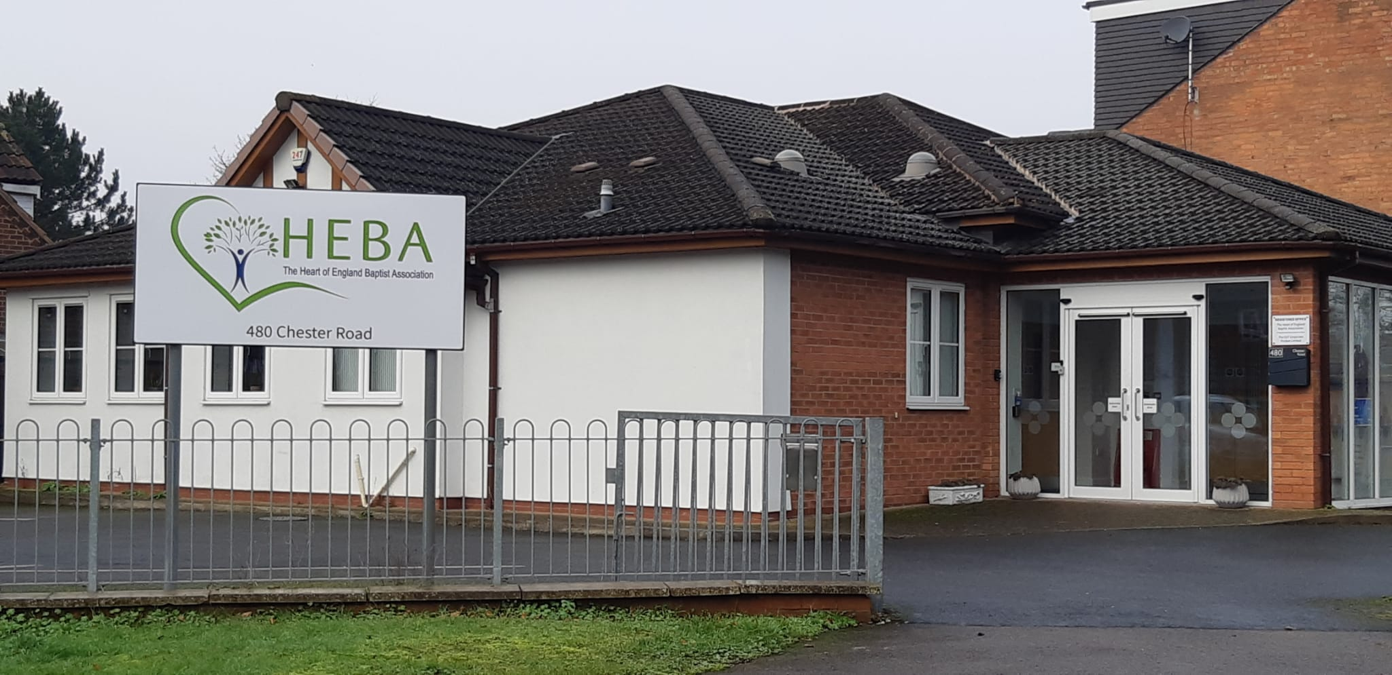
NBA
YBA
13 Regional Associations
NWBA
EMBA
HEBA
EBA
CBA
SWBA
WEBA
LBA
SWBA
SCBA
SEBA

Slide 10
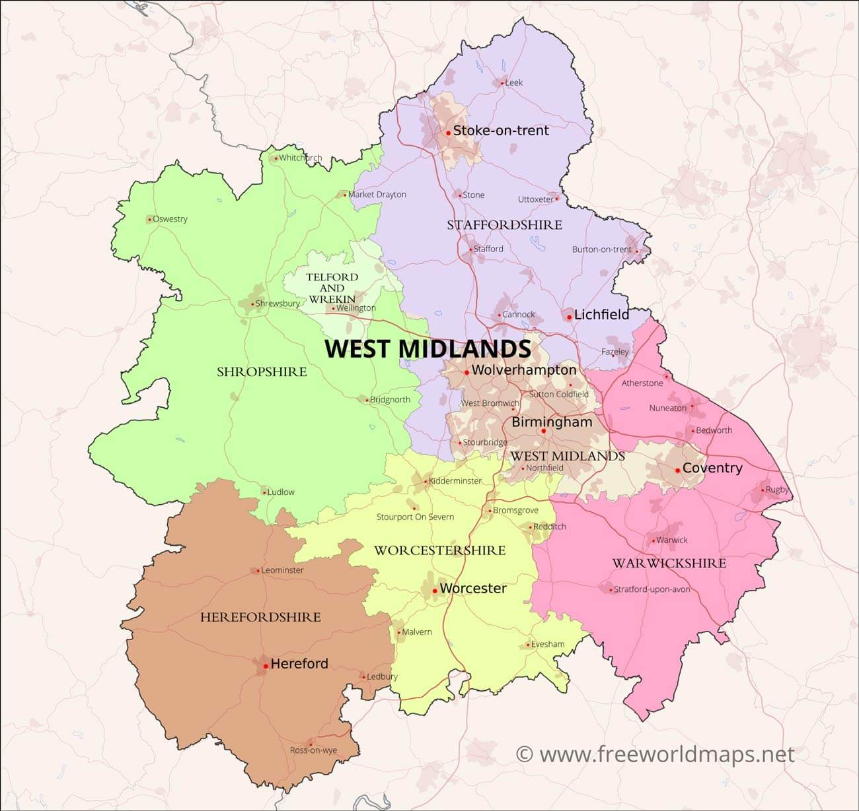
152 Churches
8500 Members

Slide 11
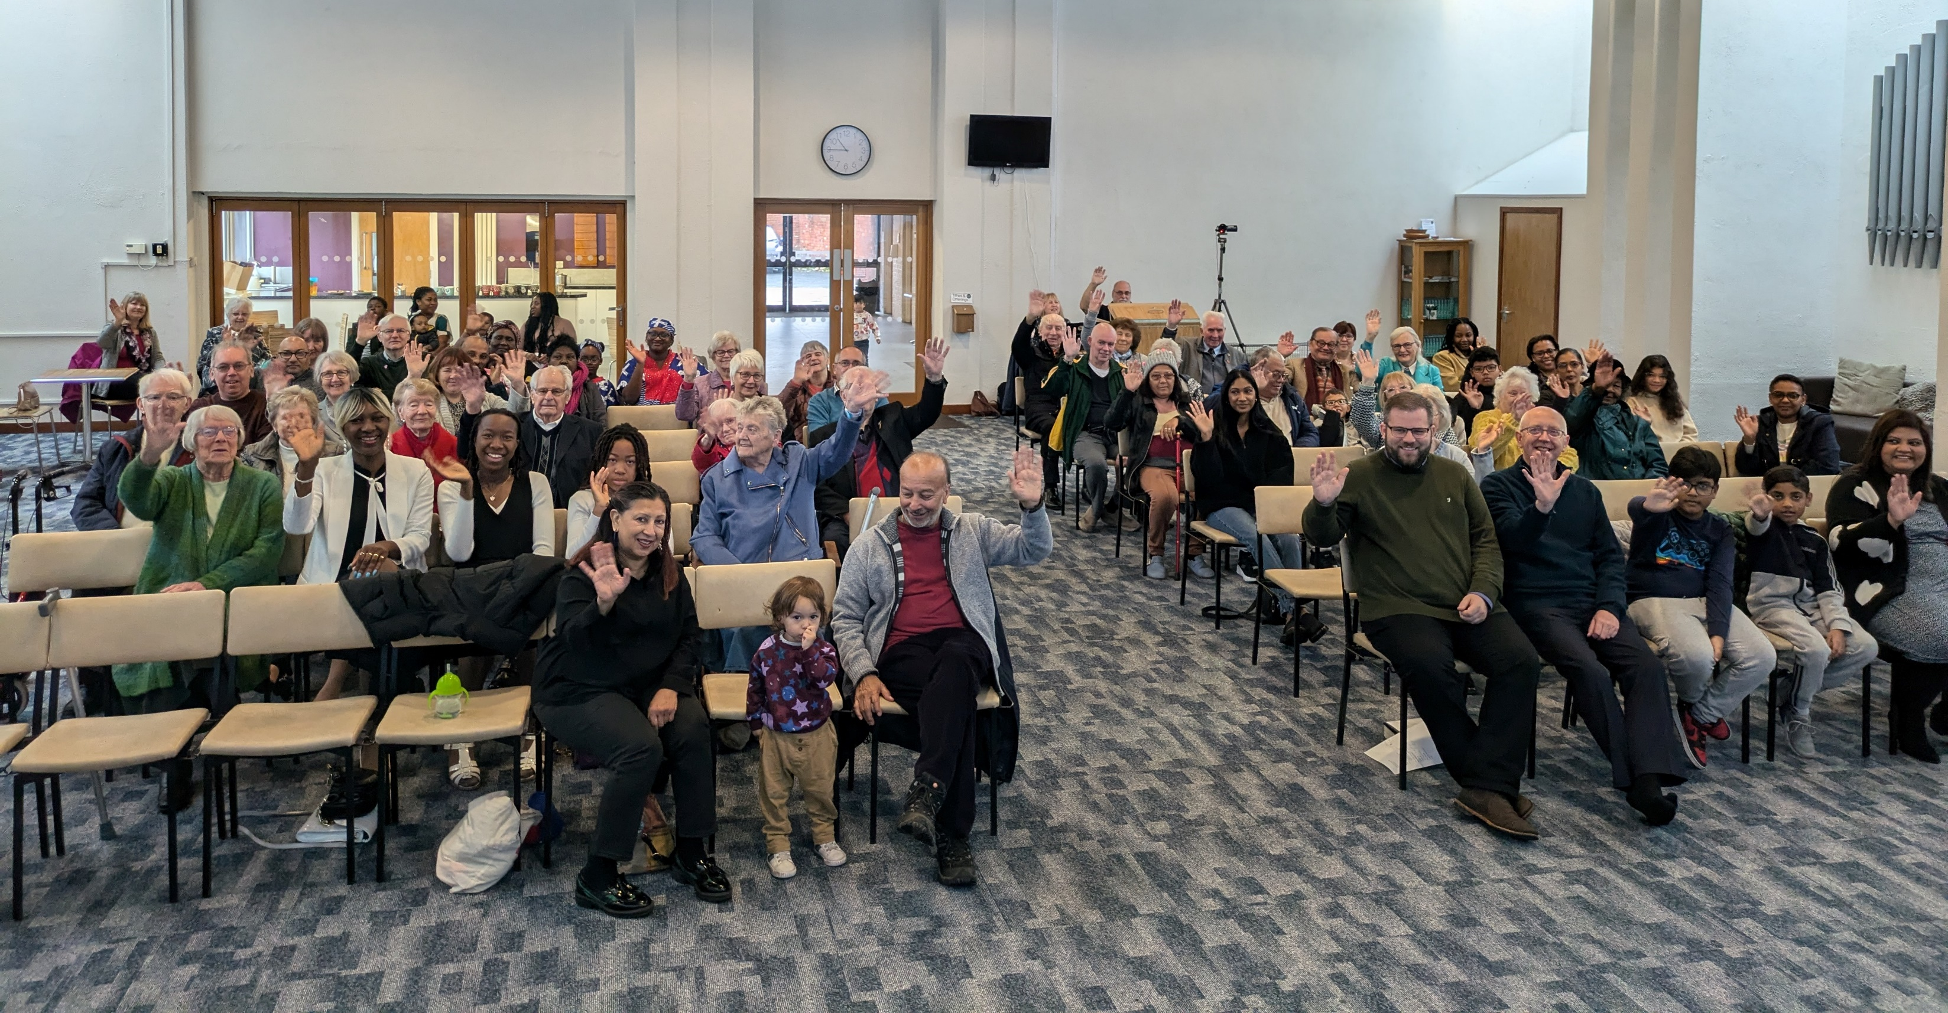
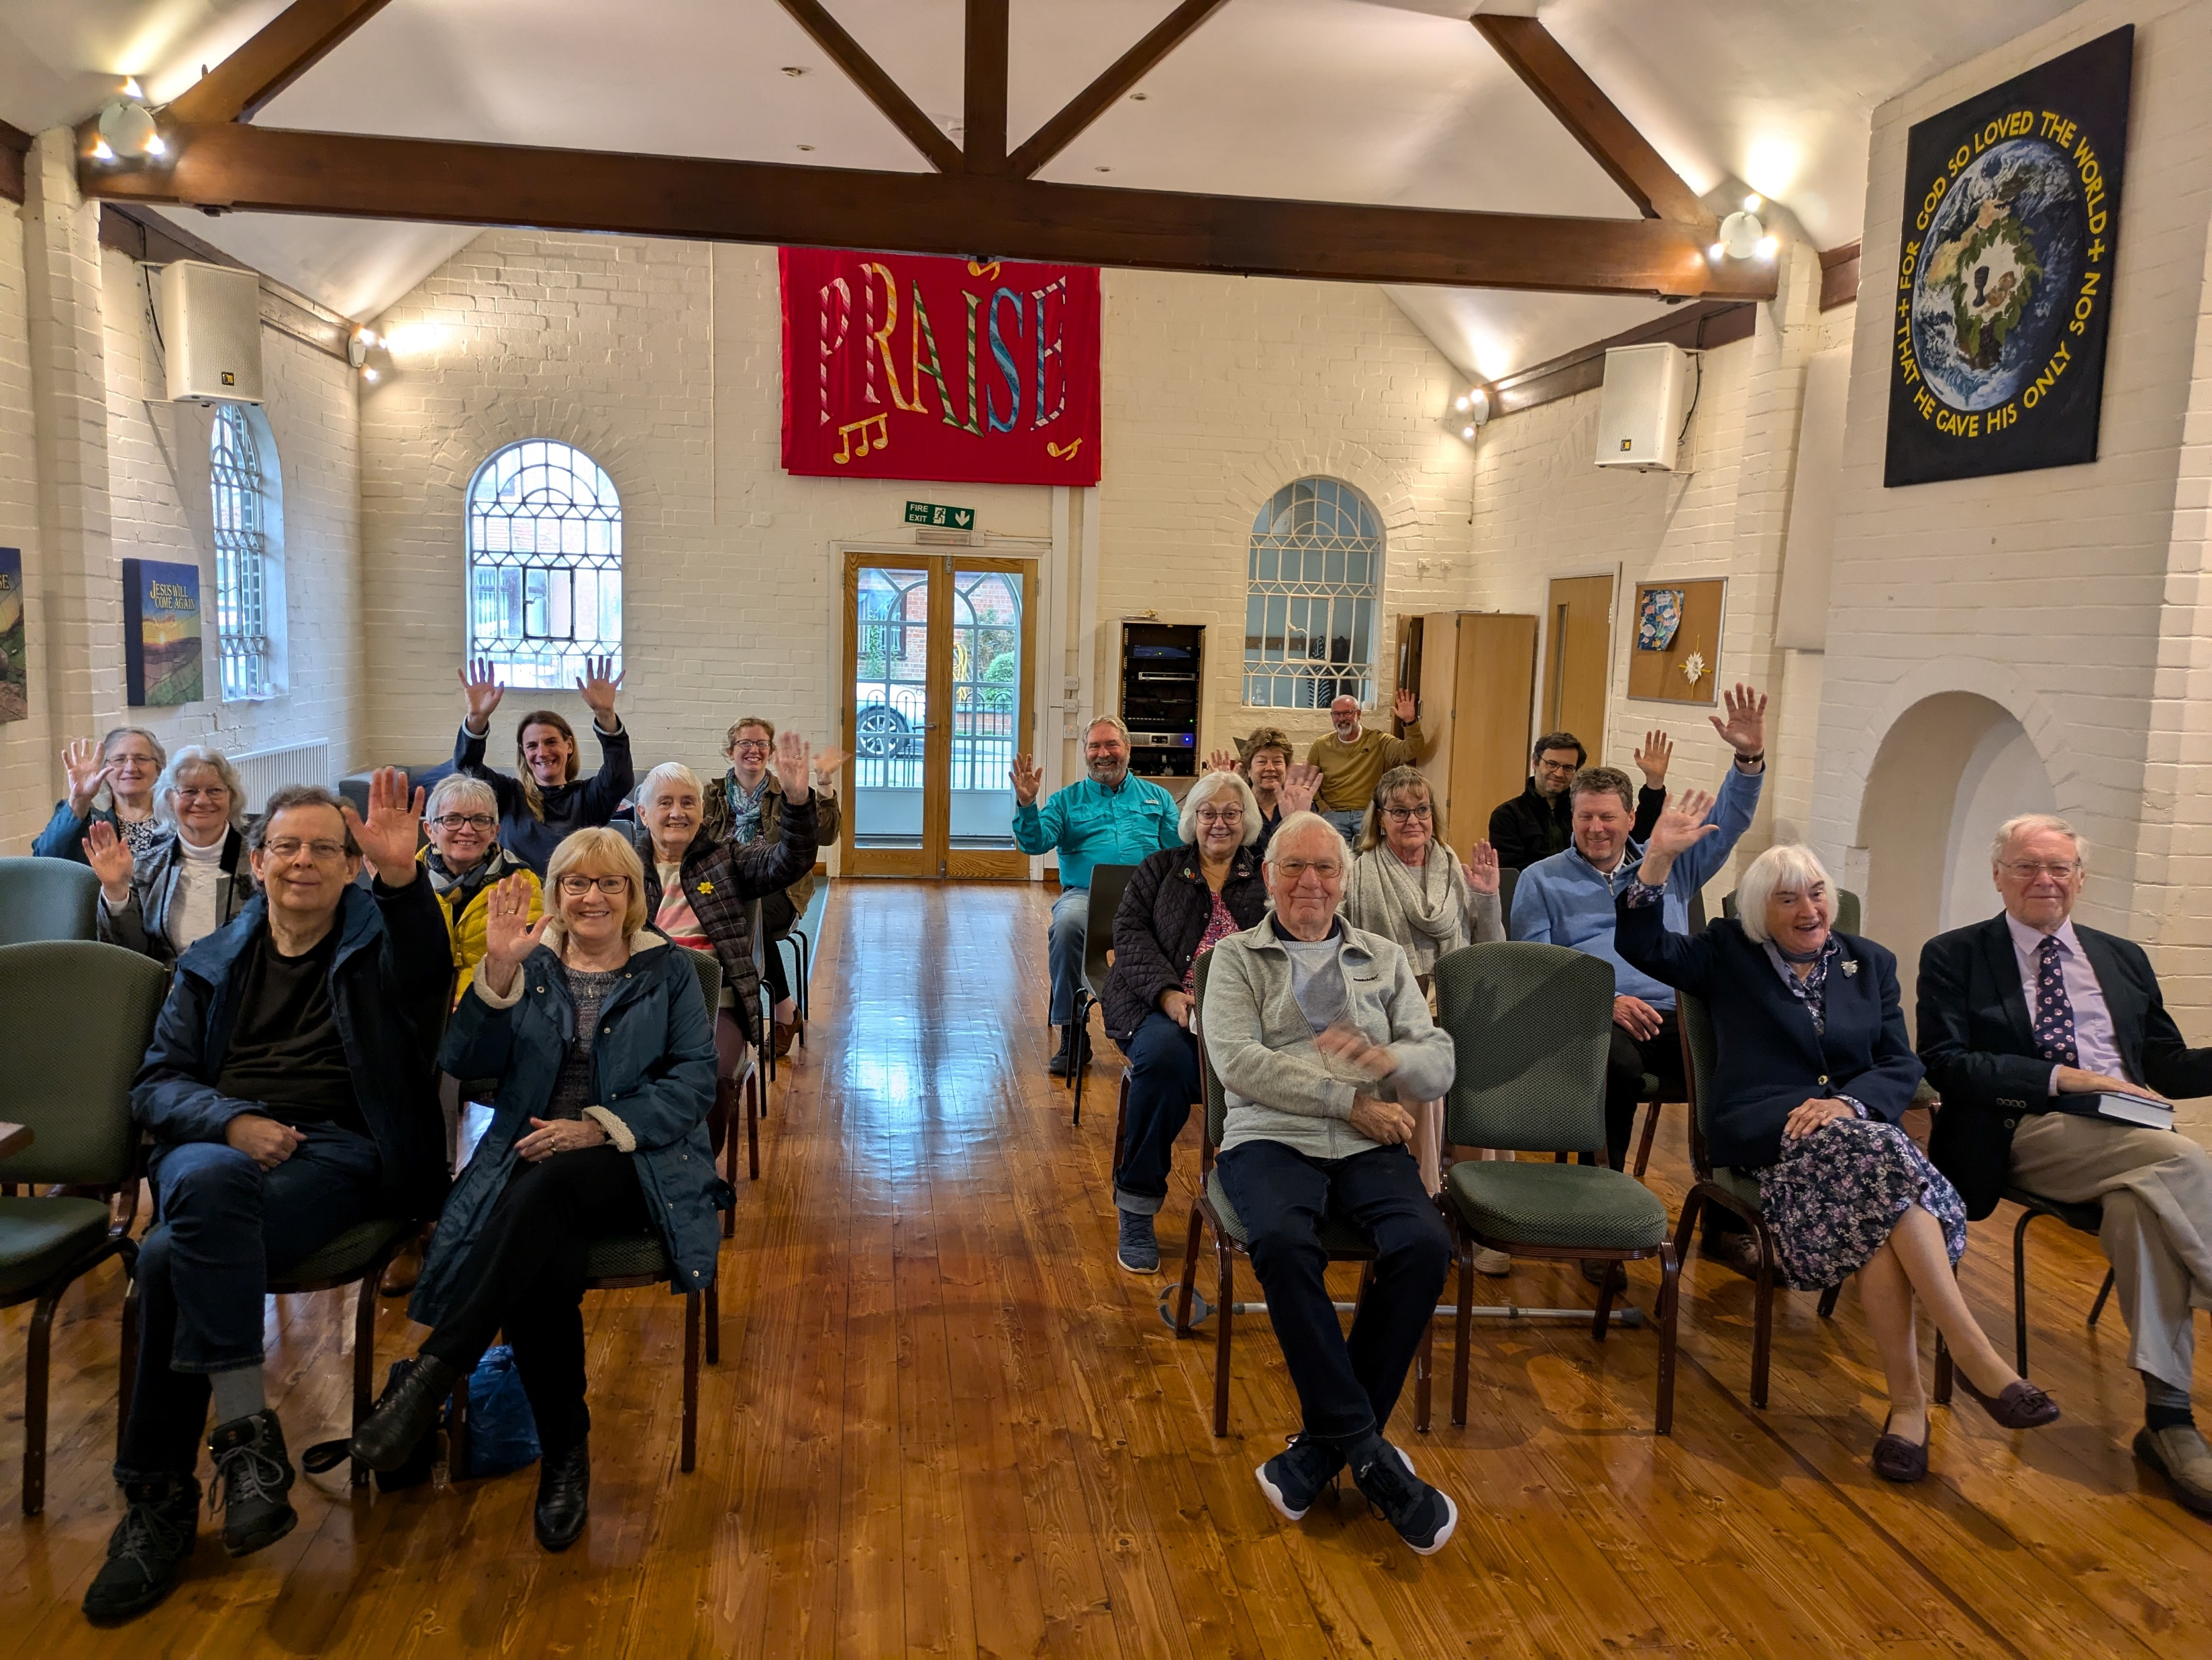
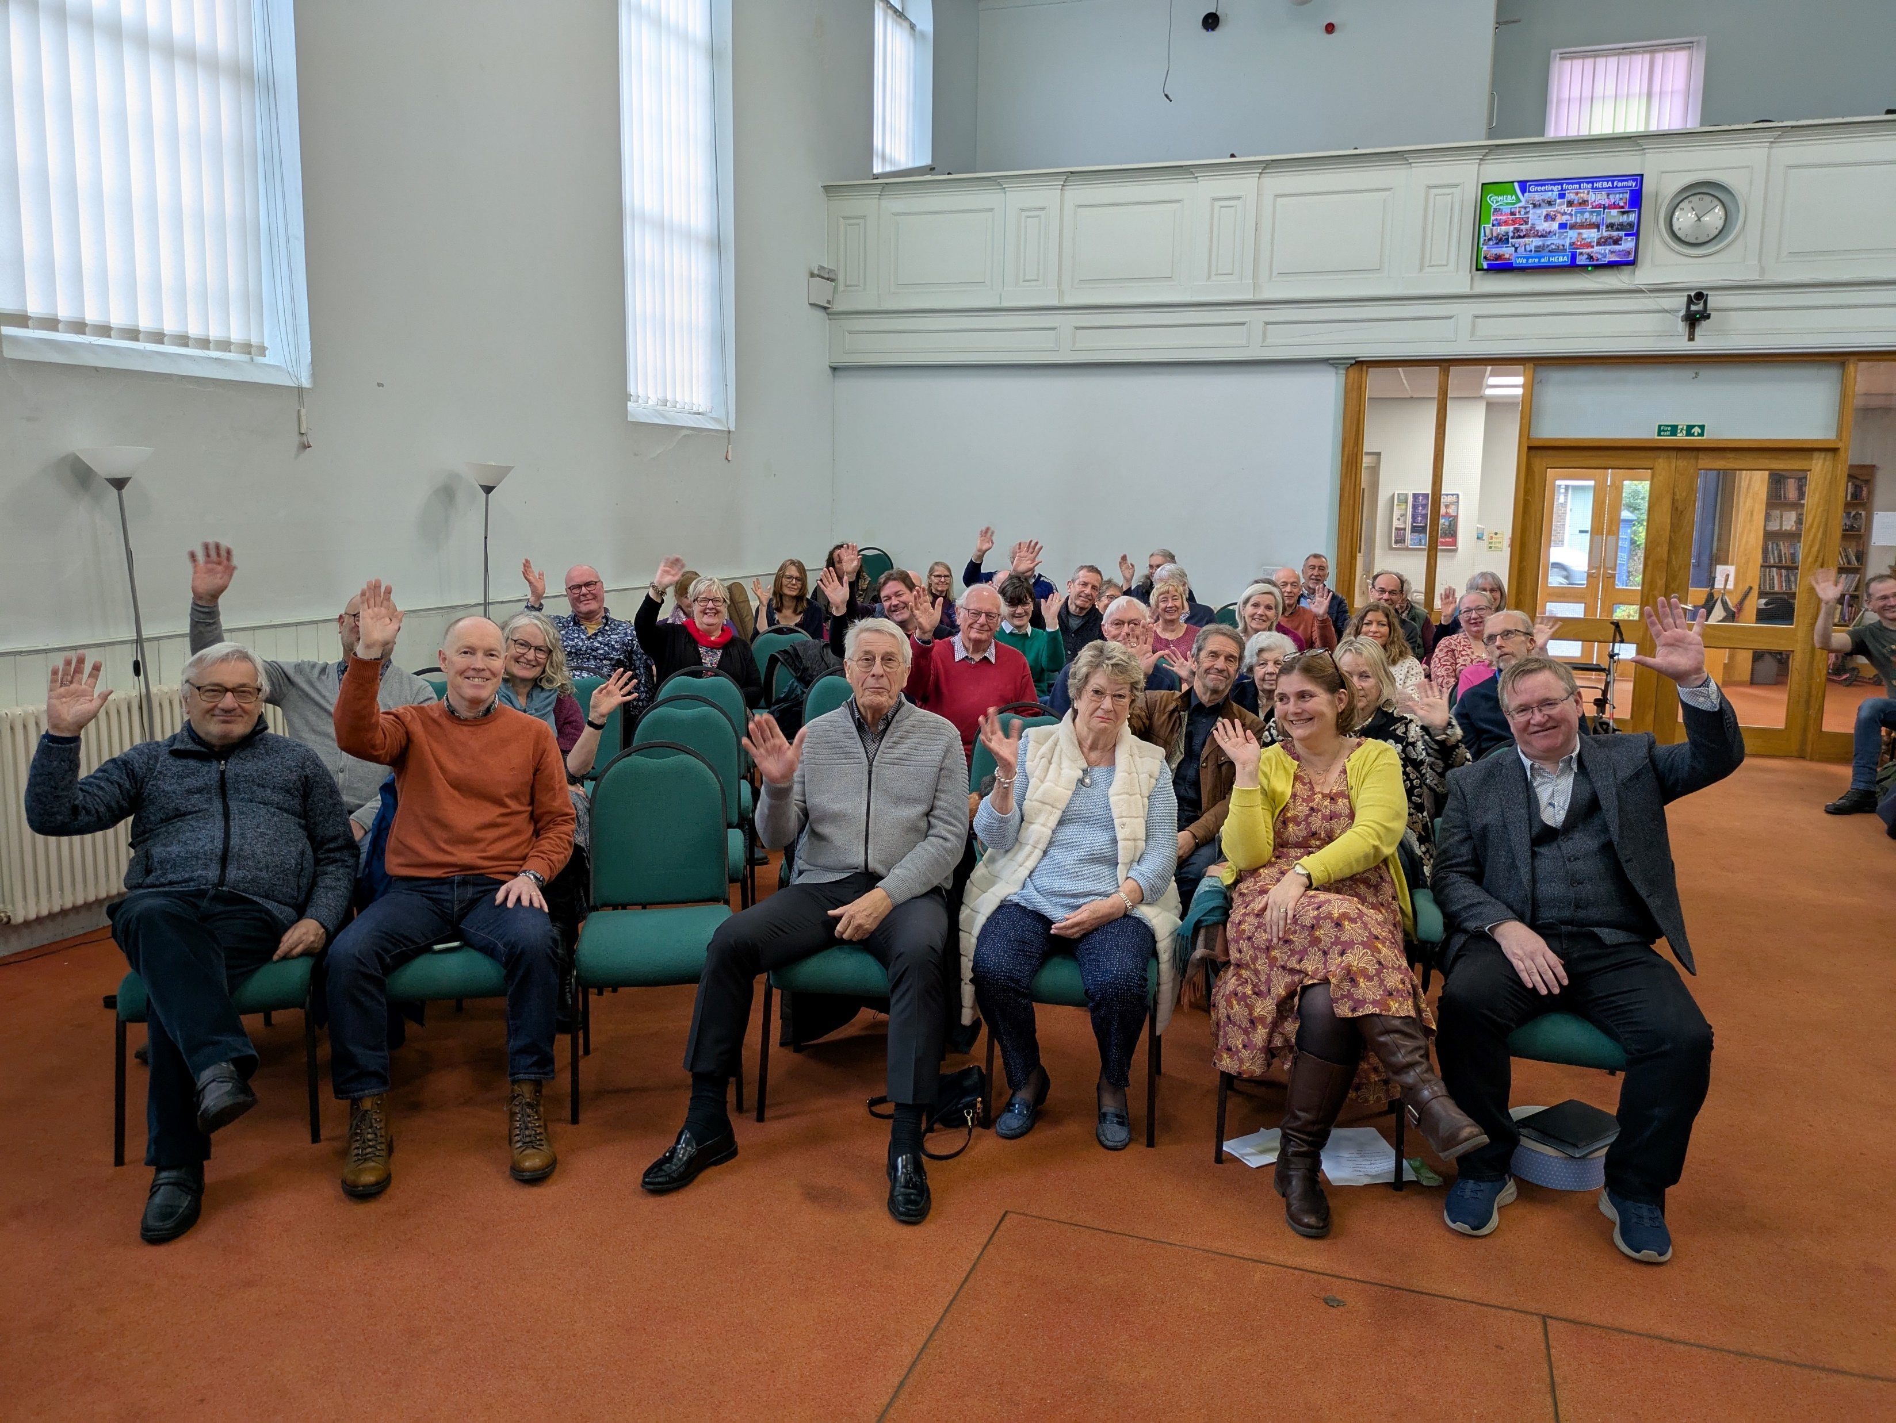
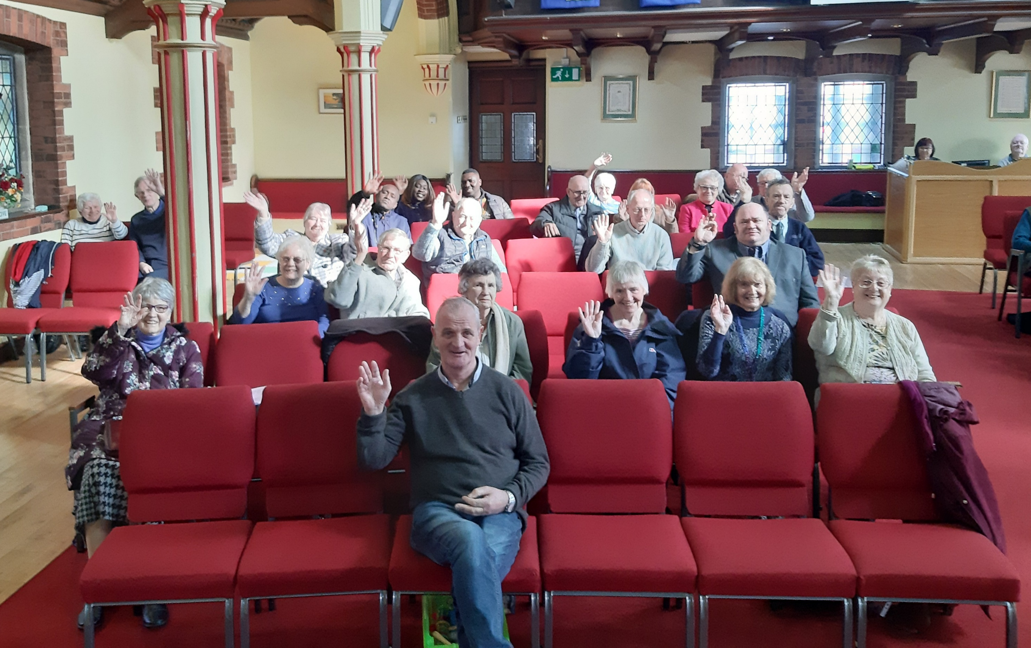
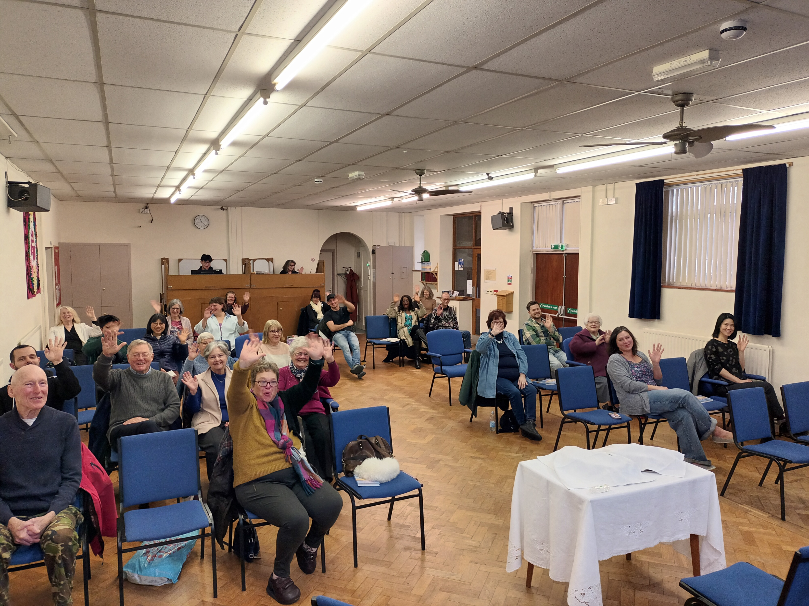
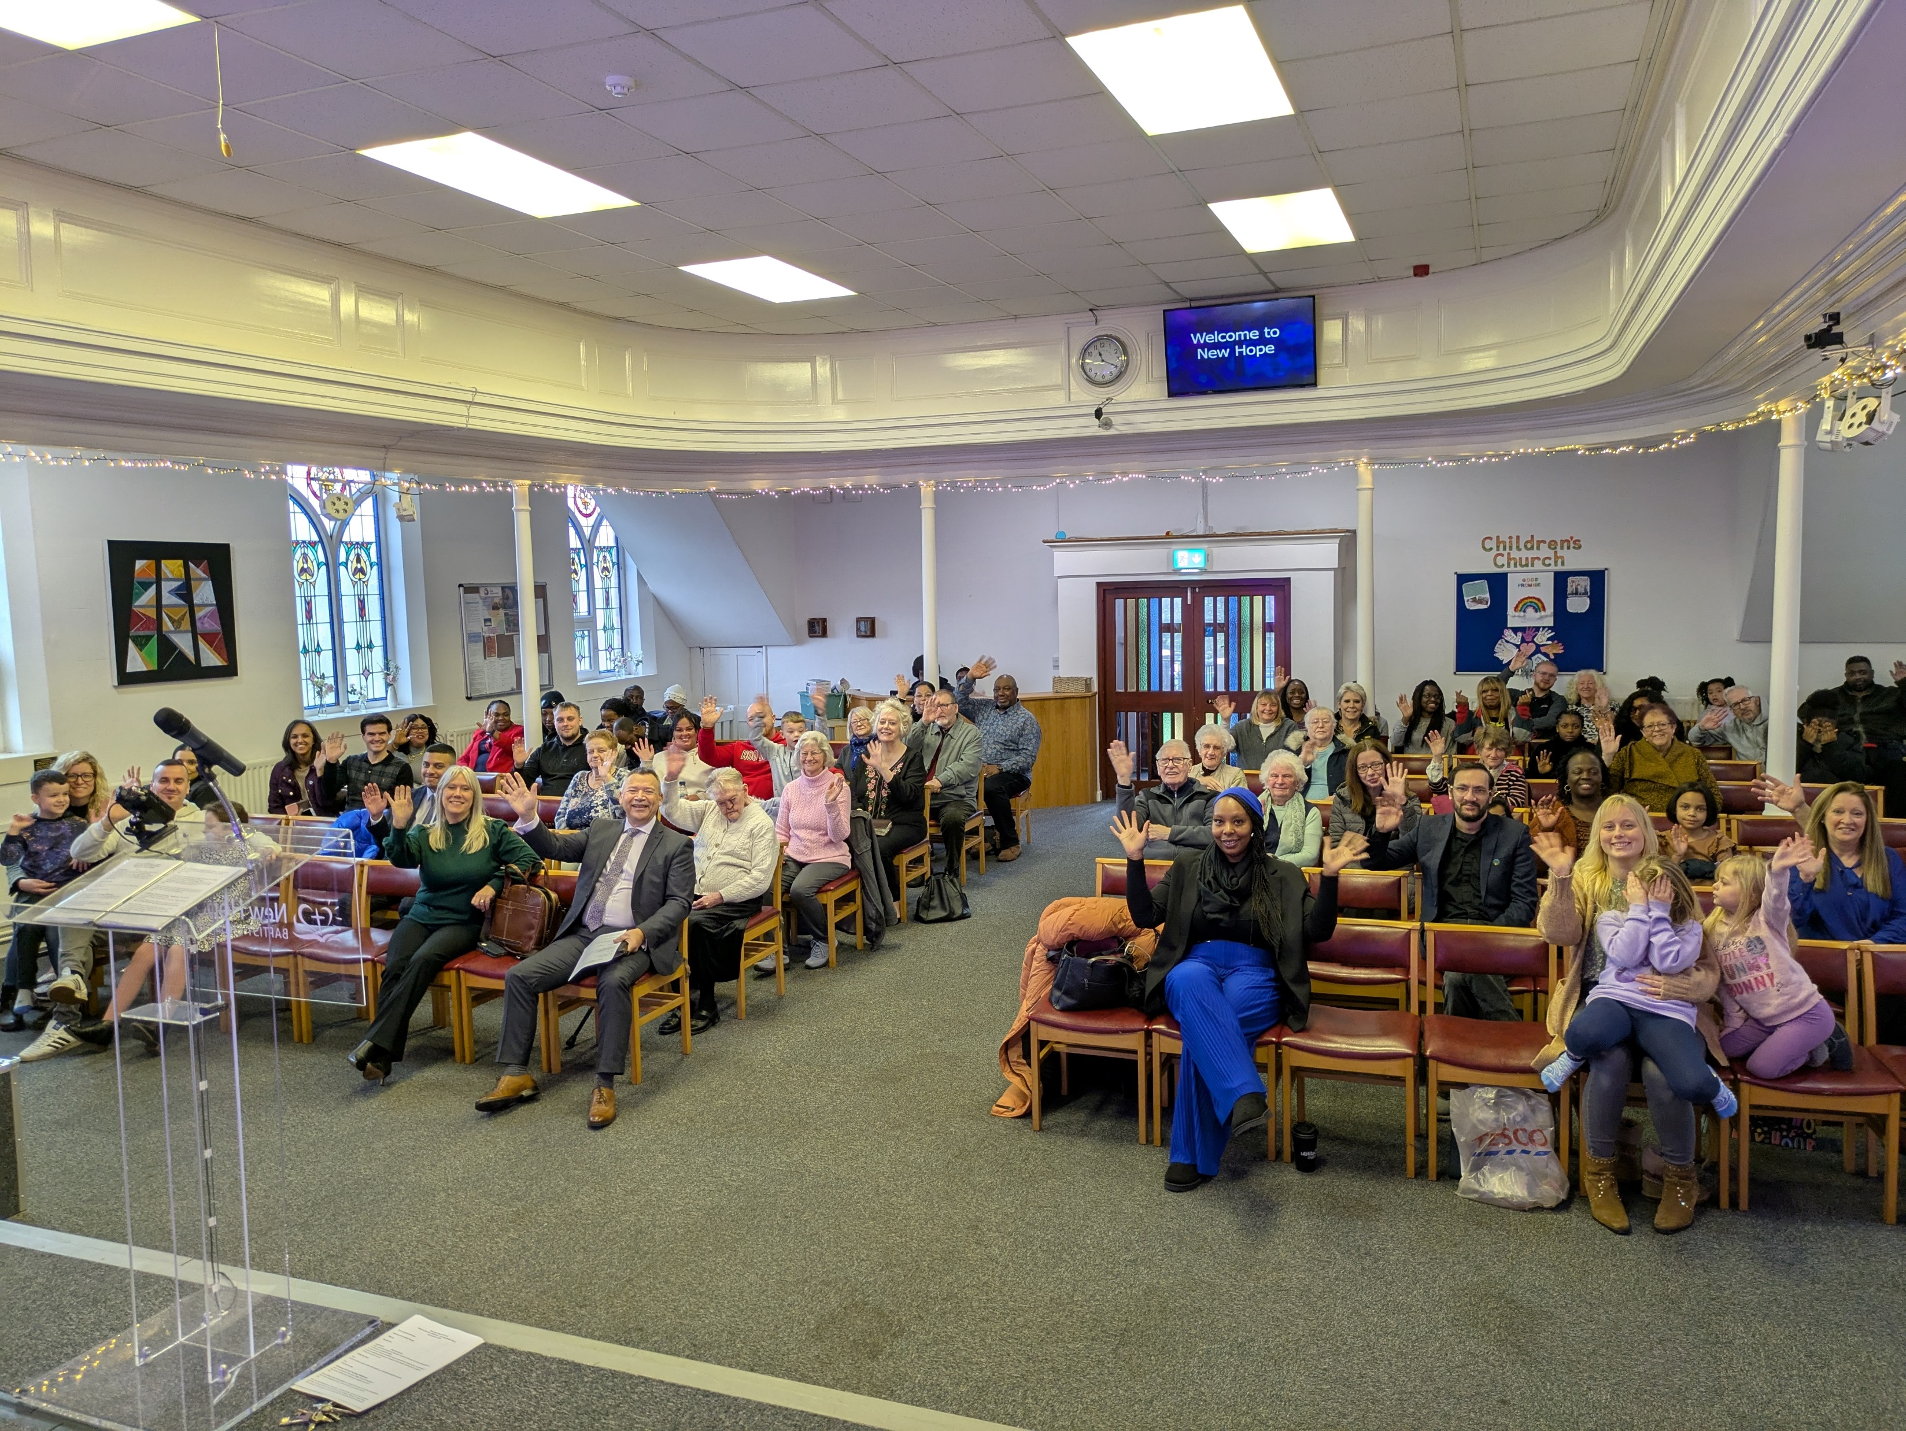
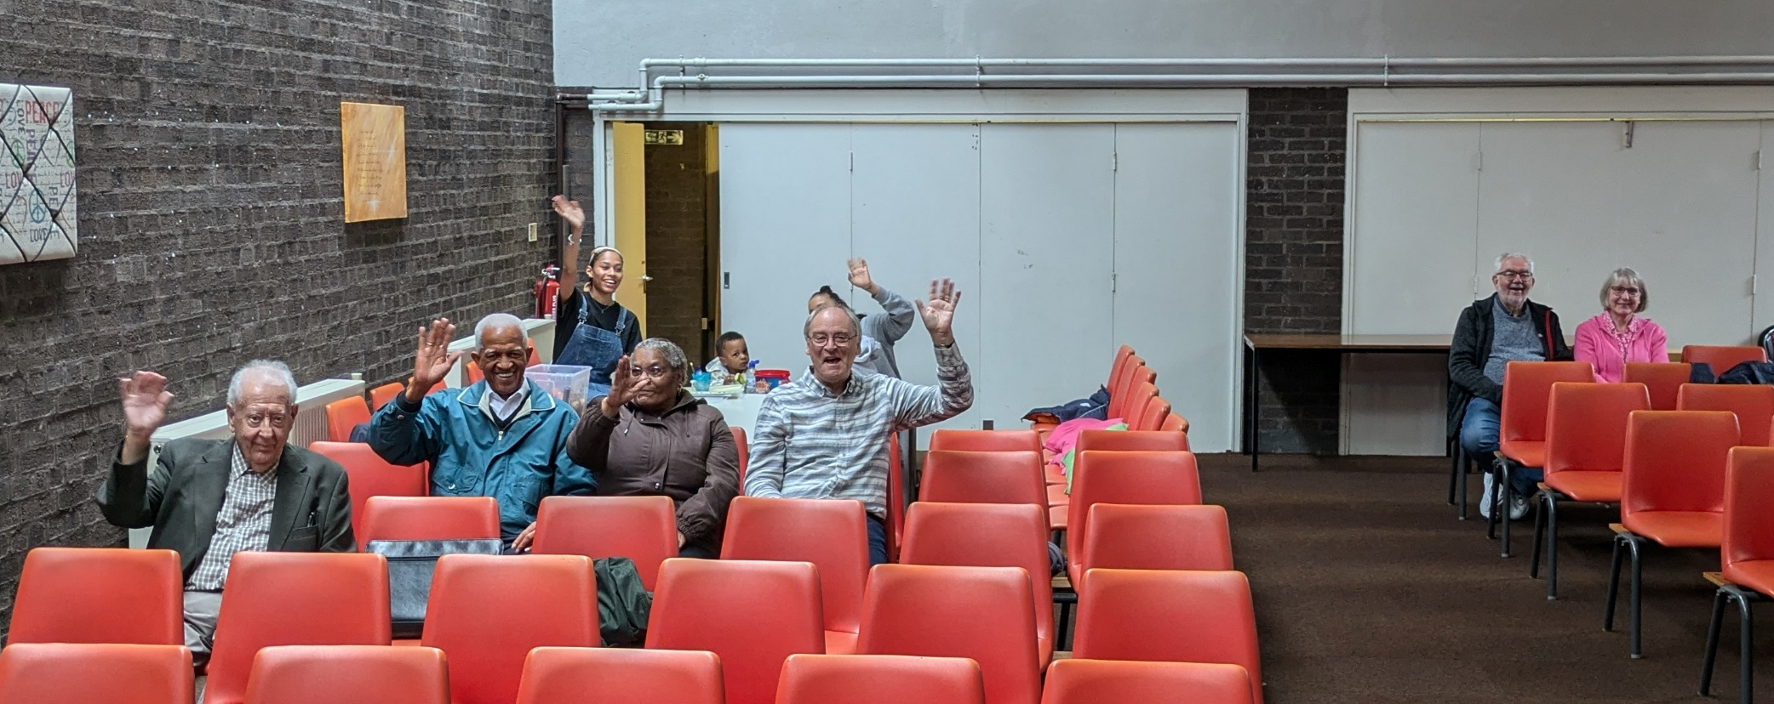
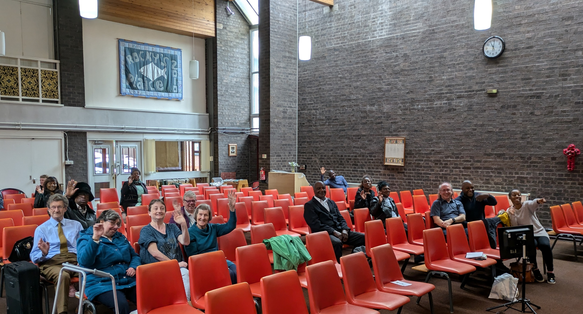
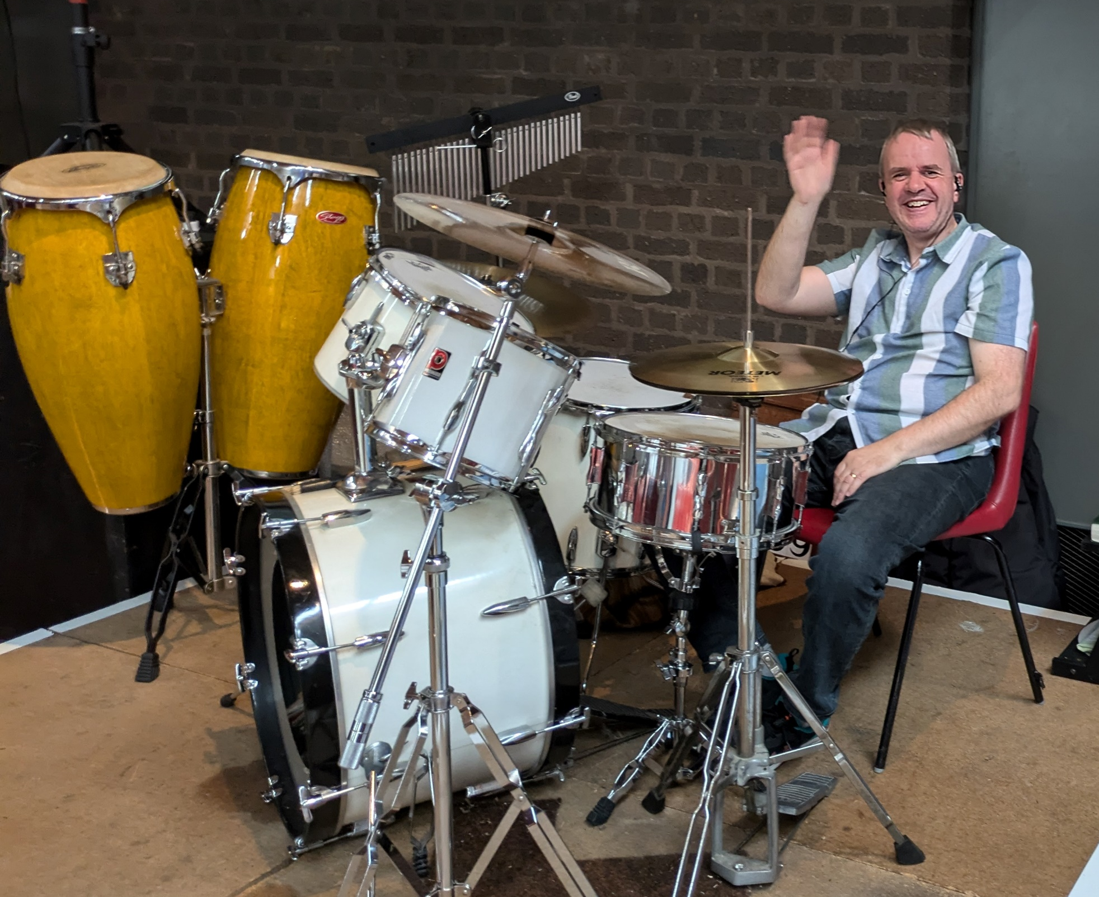
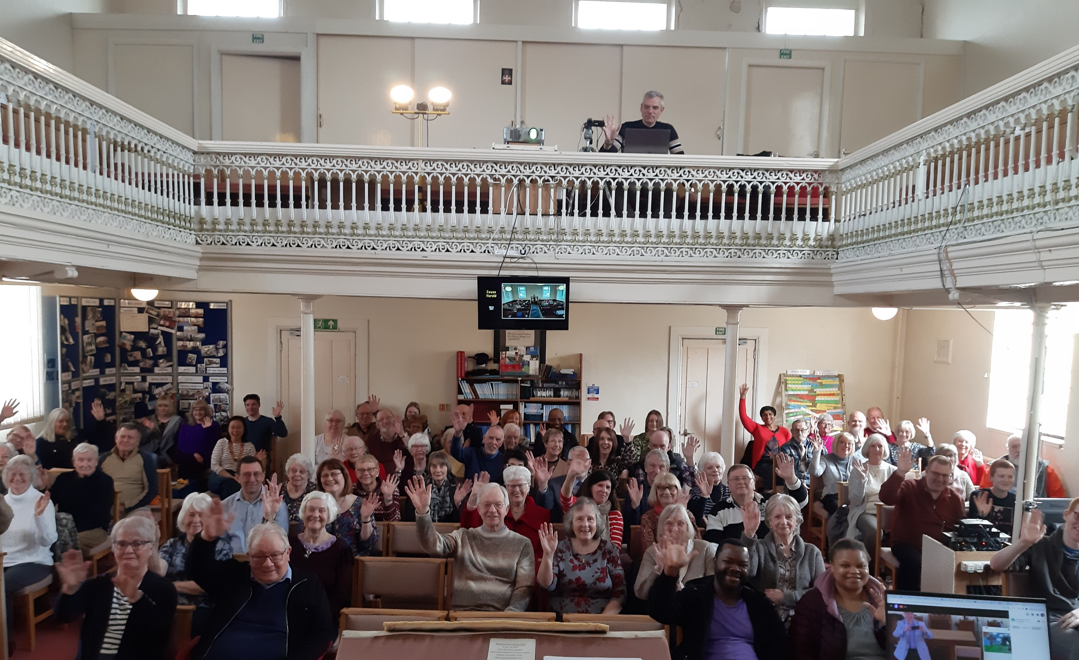
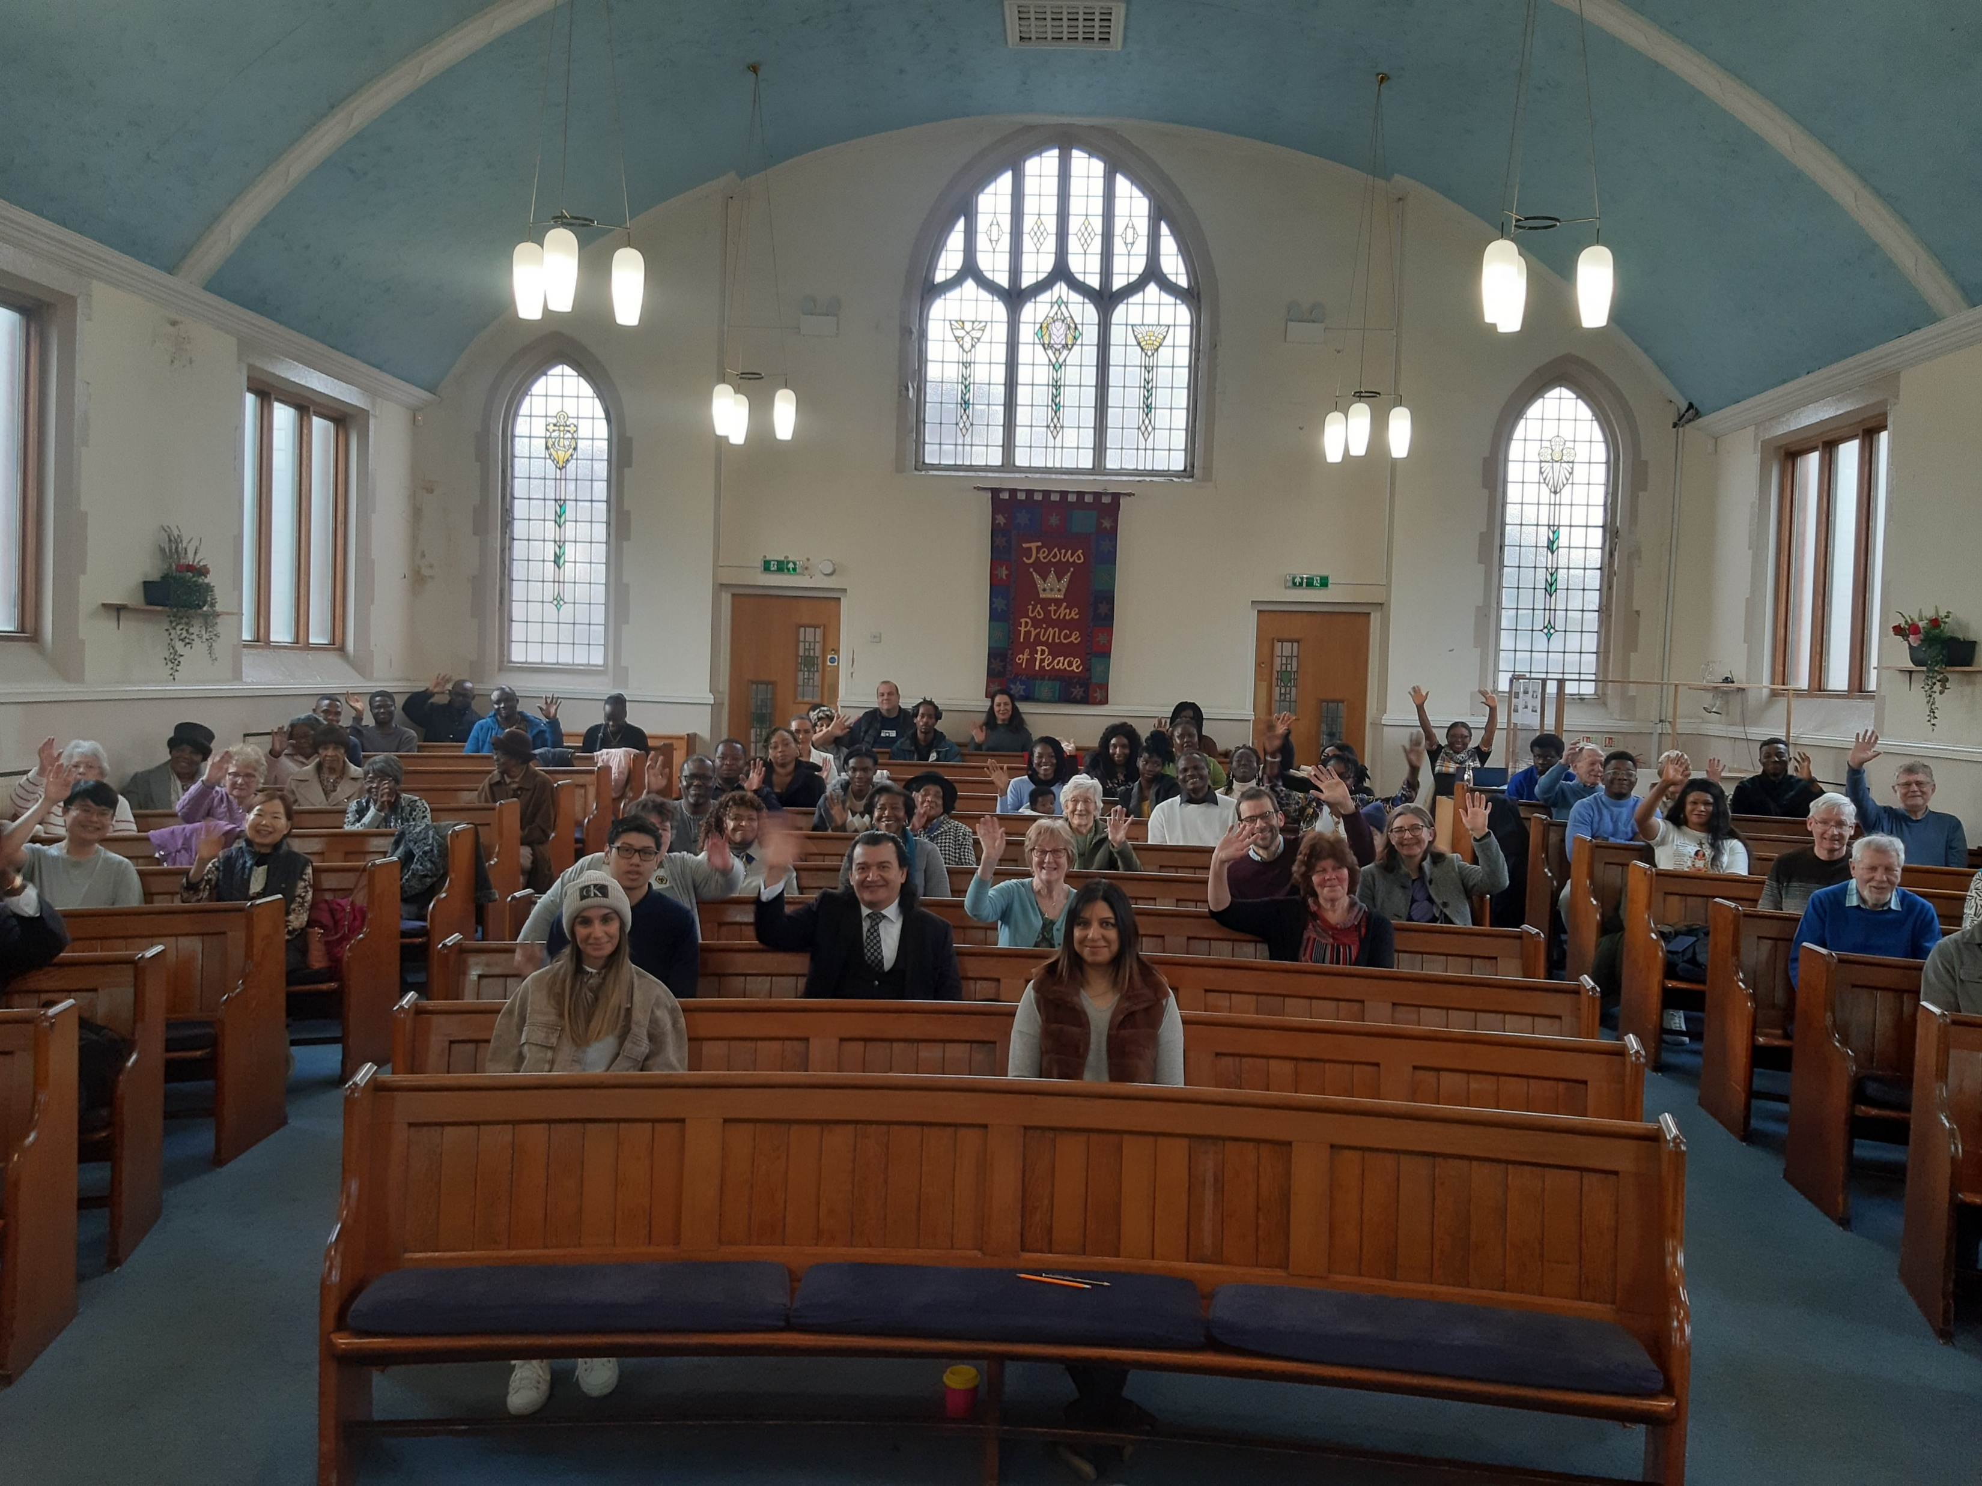
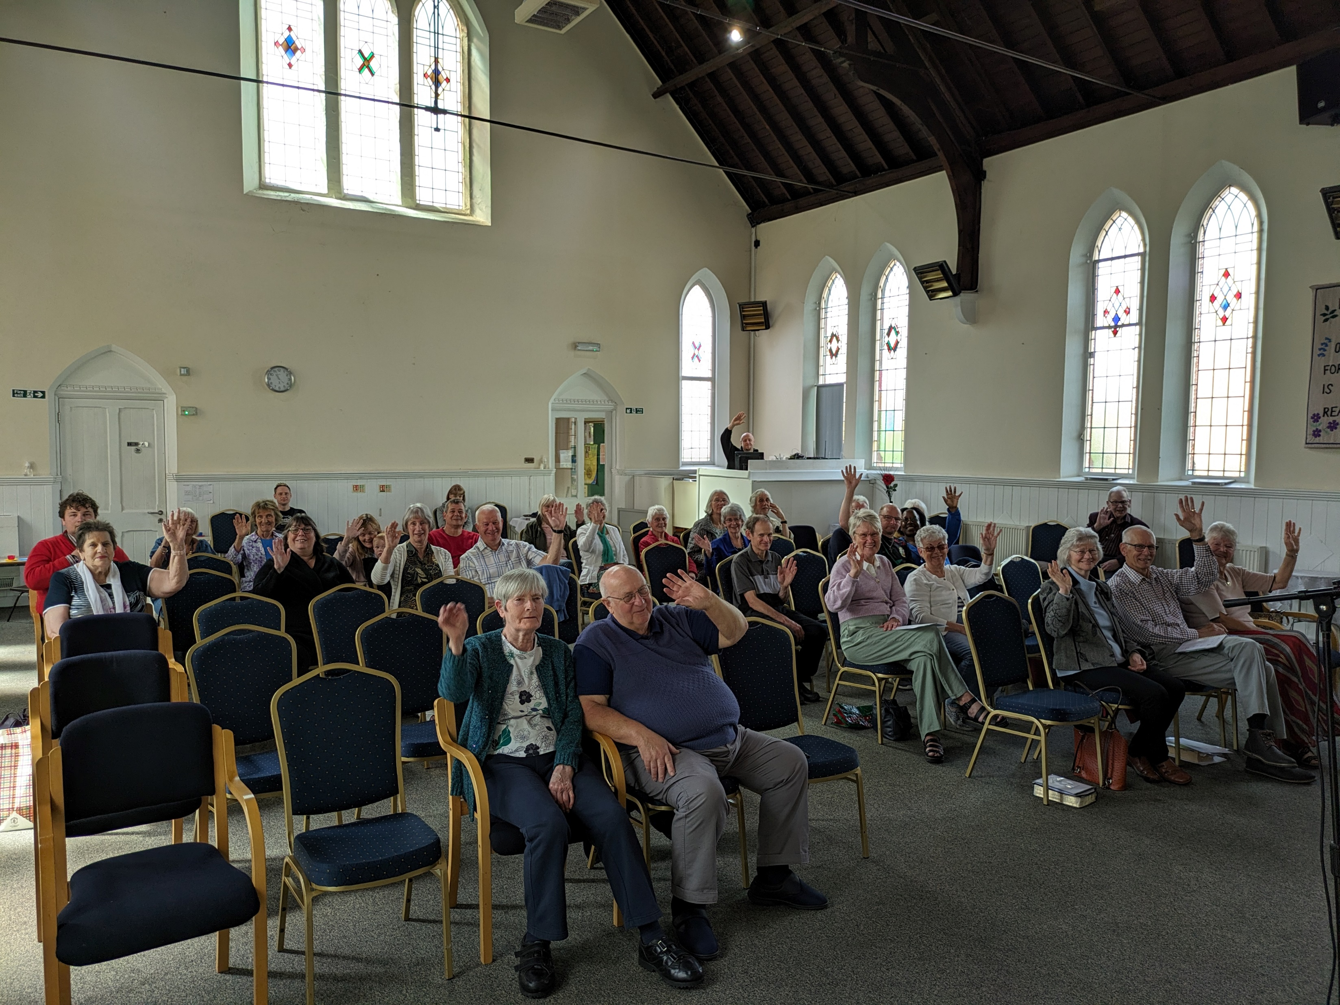
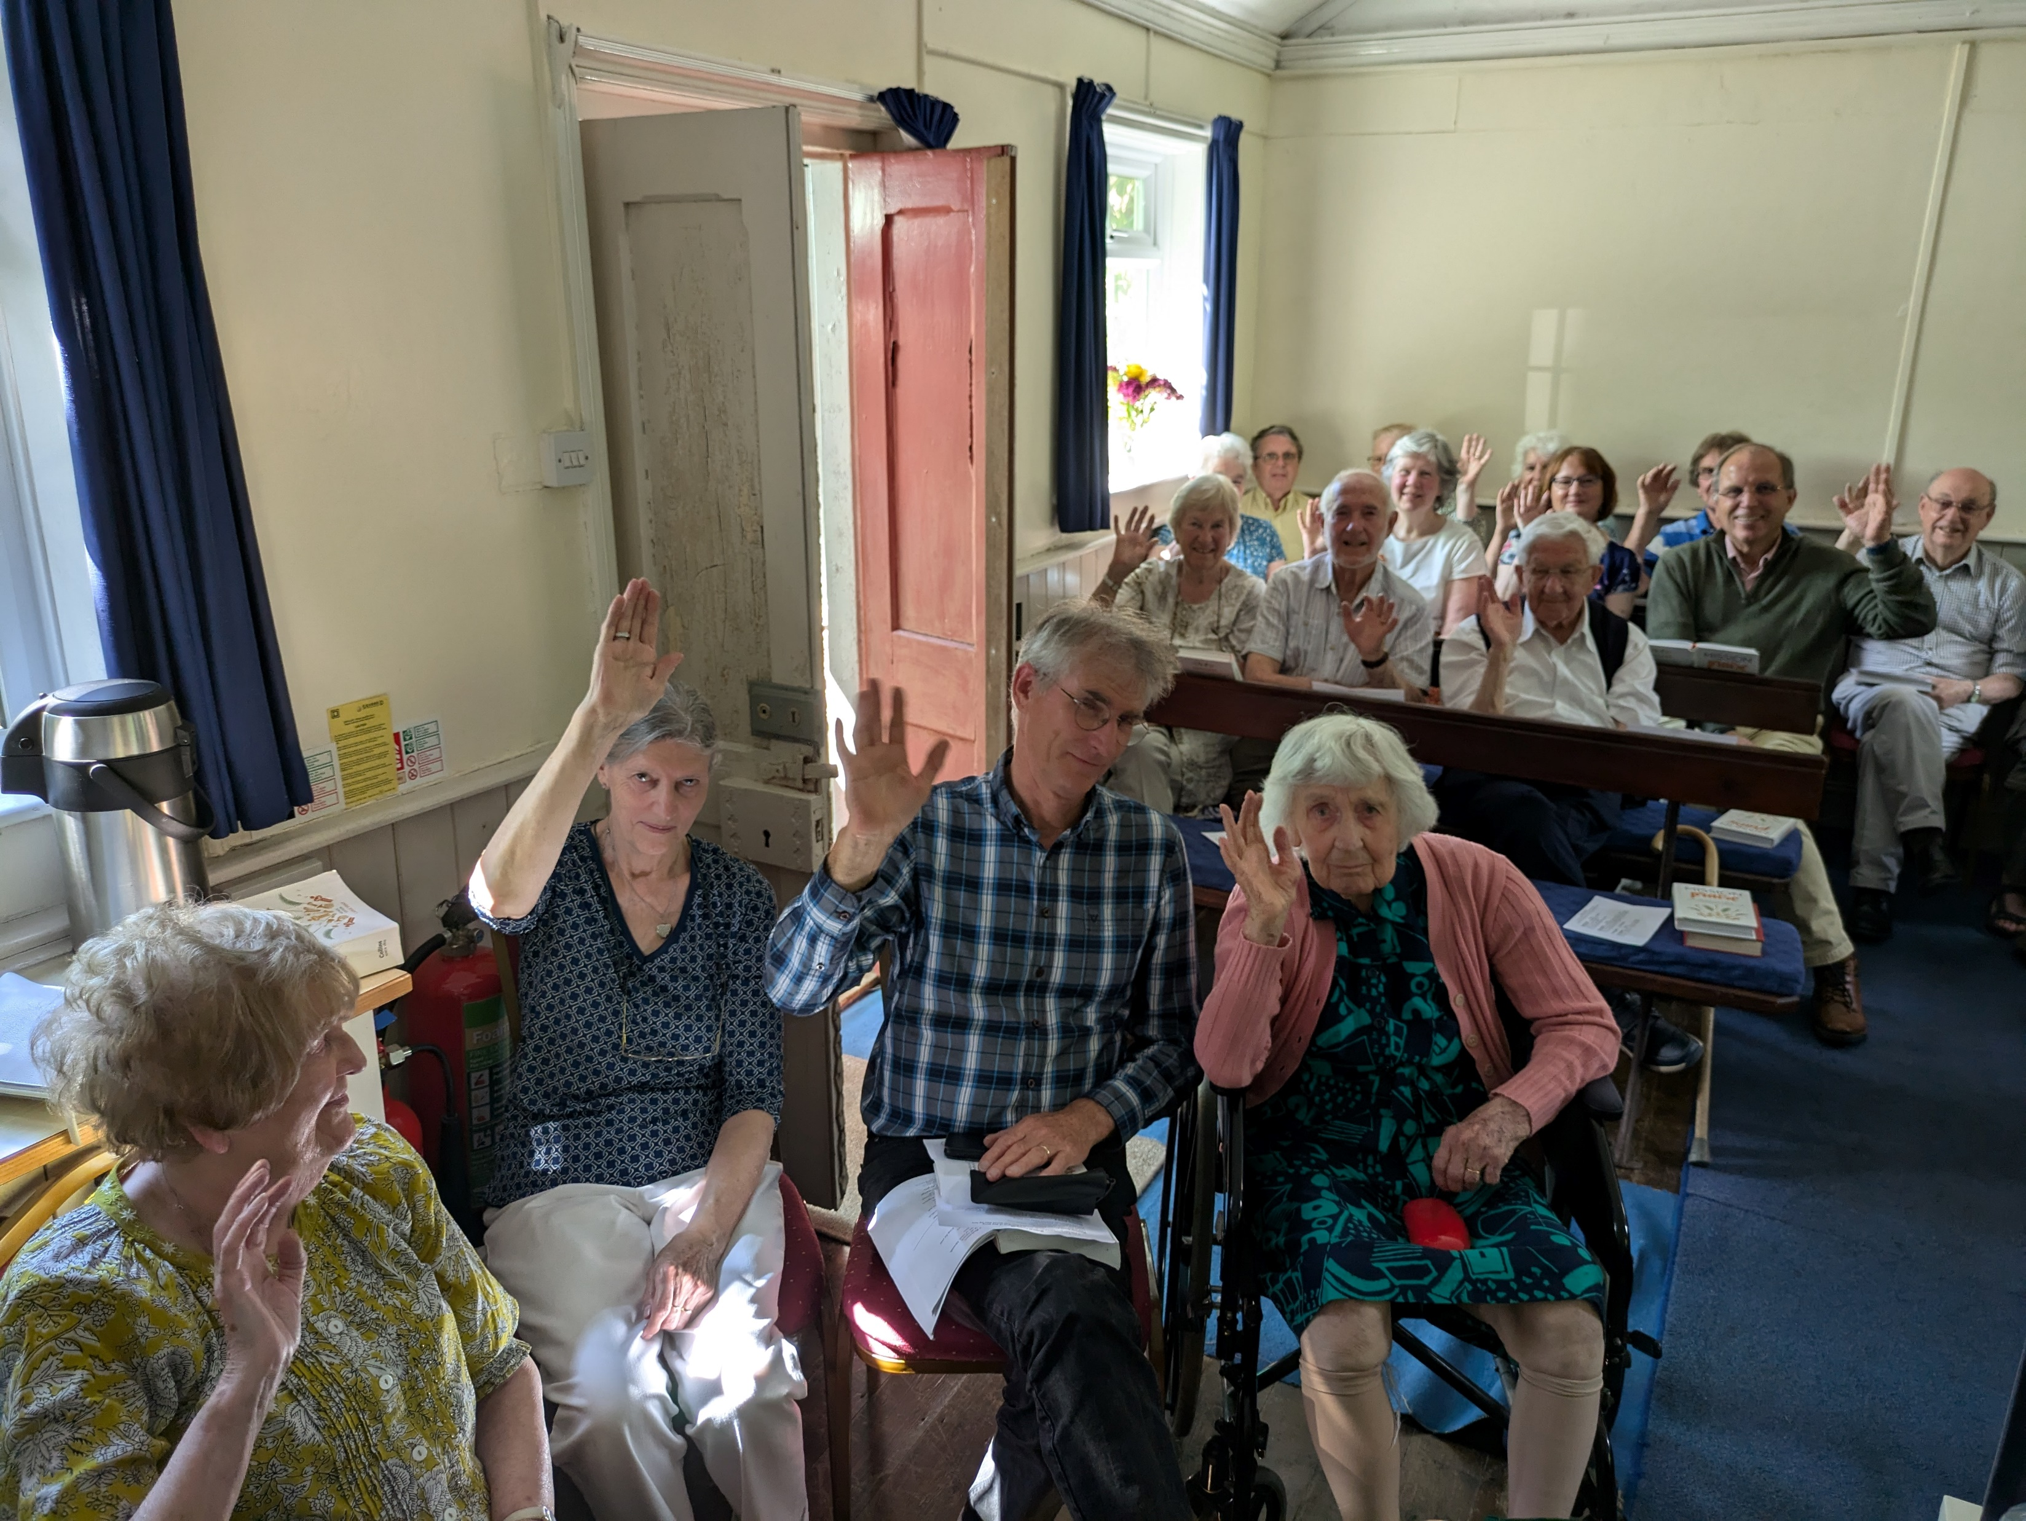
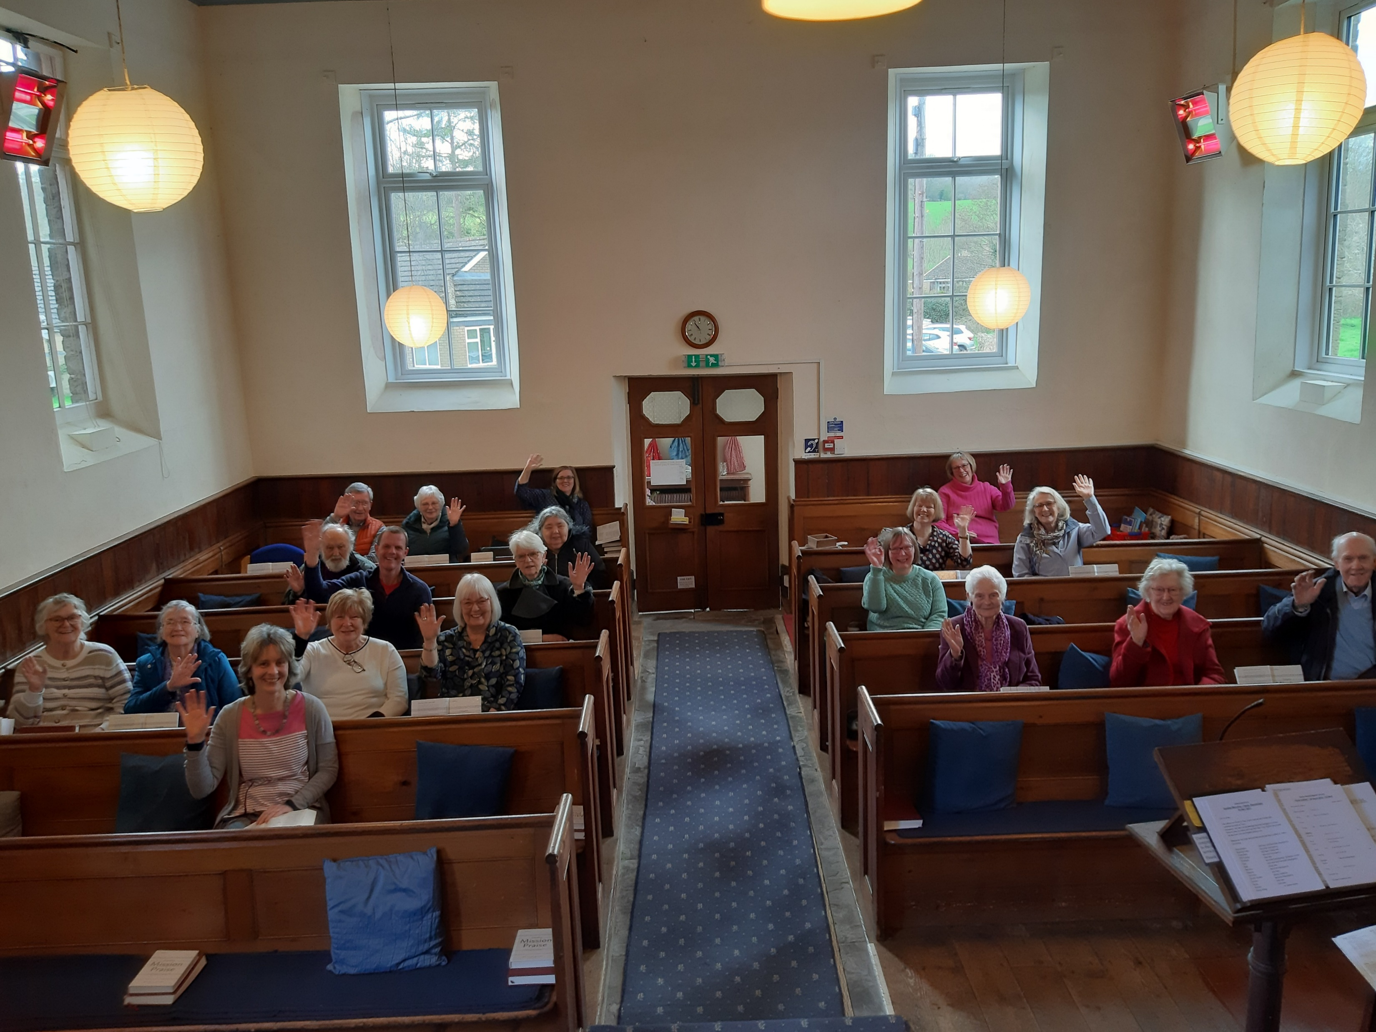
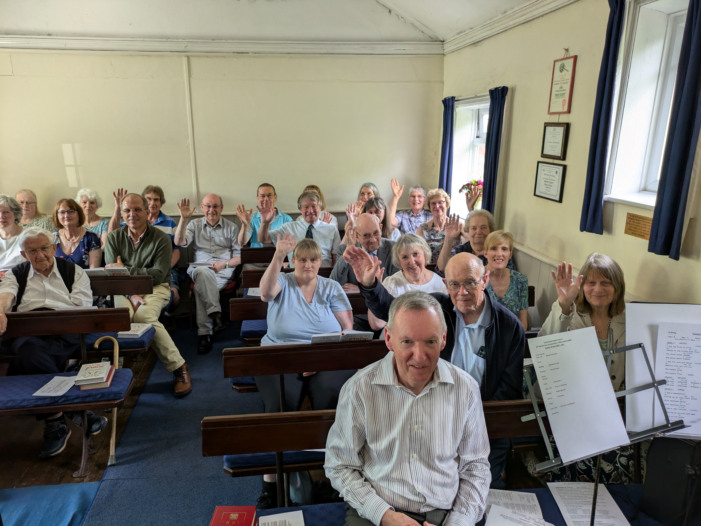
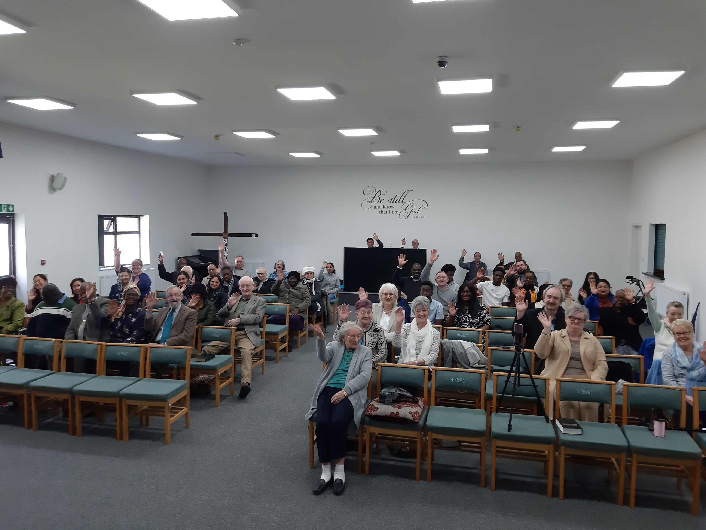
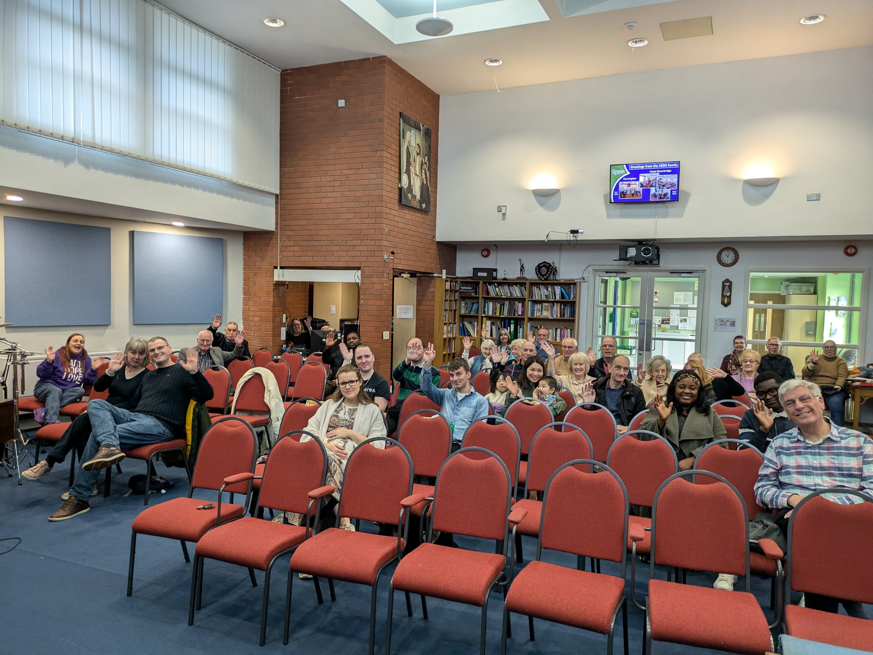
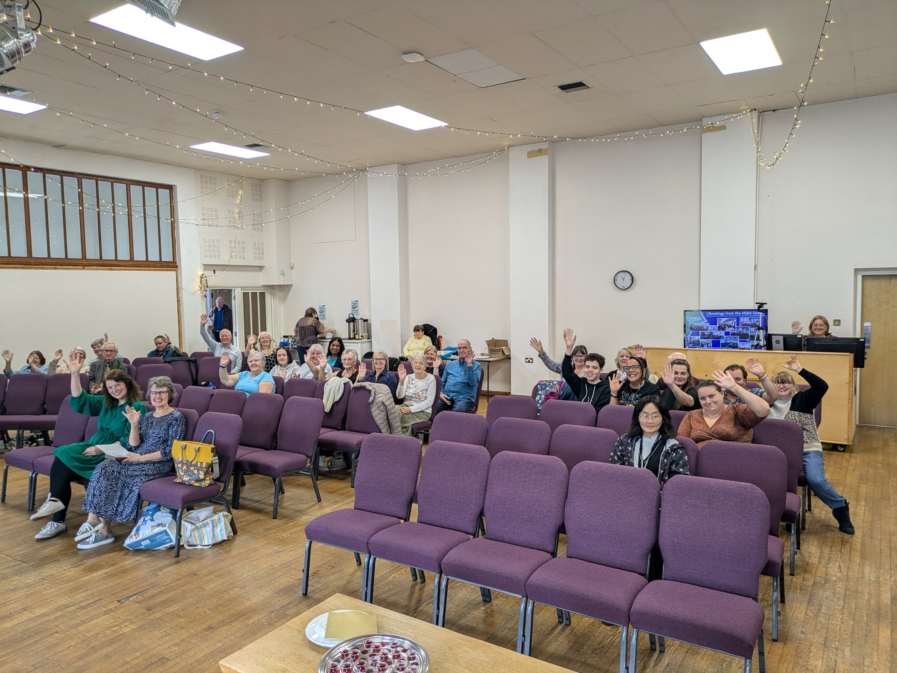
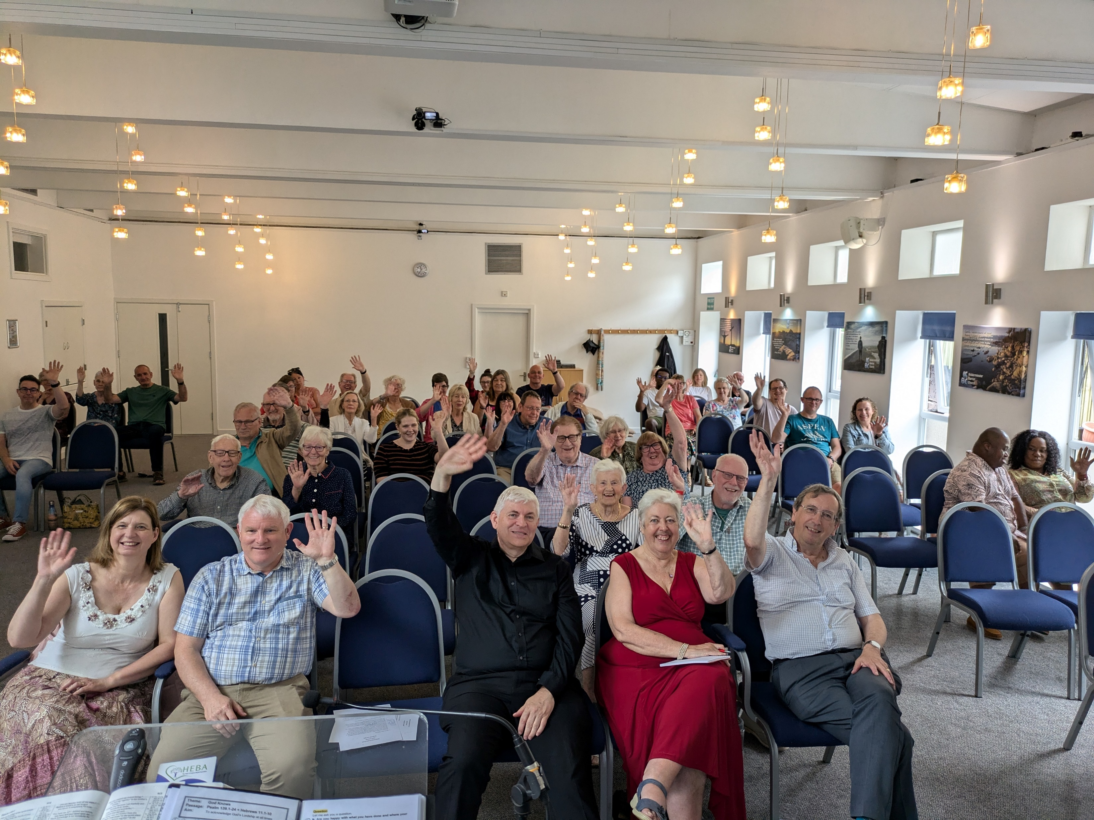
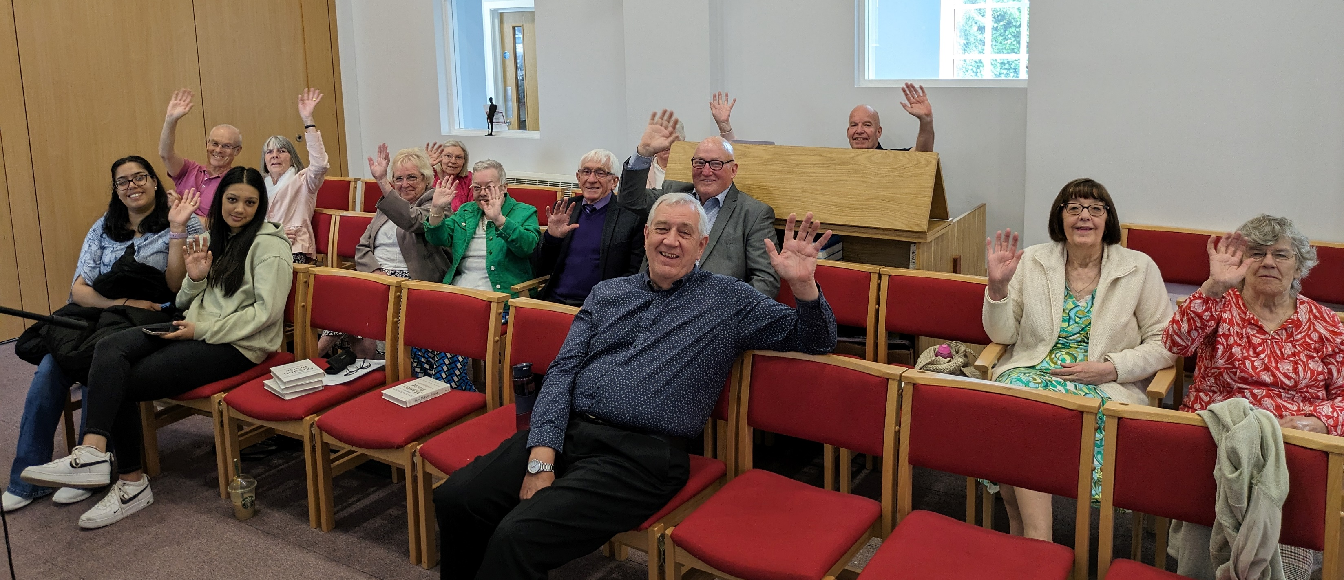
The HEBA Family
We are all HEBA

Slide 12

Looking Forward……

Slide 13
→ Pilot a new structure – Pastoral Ministers

Slide 14
→ Pilot a new structure – Pastoral Ministers
→ Appoint 50% Regional Minister

Slide 15
→ Pilot a new structure – Pastoral Ministers
→ Appoint 50% Regional Minister
→ National Financial Review

Slide 16
→ Pilot a new structure – Pastoral Ministers
→ Appoint 50% Regional Minister
→ National Financial Review
→ Succession Planning

Slide 17
→ Pilot a new structure – Pastoral Ministers
→ Appoint 50% Regional Minister
→ National Financial Review
→ Succession Planning
→ Priorities – companionship + governance

Slide 18
→ Pilot a new structure – Pastoral Ministers
→ Appoint 50% Regional Minister
→ National Financial Review
→ Succession Planning
→ Priorities – companionship + governance
→ Project Violet

Slide 19
→ Pilot a new structure – Pastoral Ministers
→ Appoint 50% Regional Minister
→ National Financial Review
→ Succession Planning
→ Priorities – companionship + governance
→ Project Violet
→ Justice Hubs – disability focus

