Slide 1

The Heart of England Baptist Association Trustees’ Training 11 October 2025

Slide 2
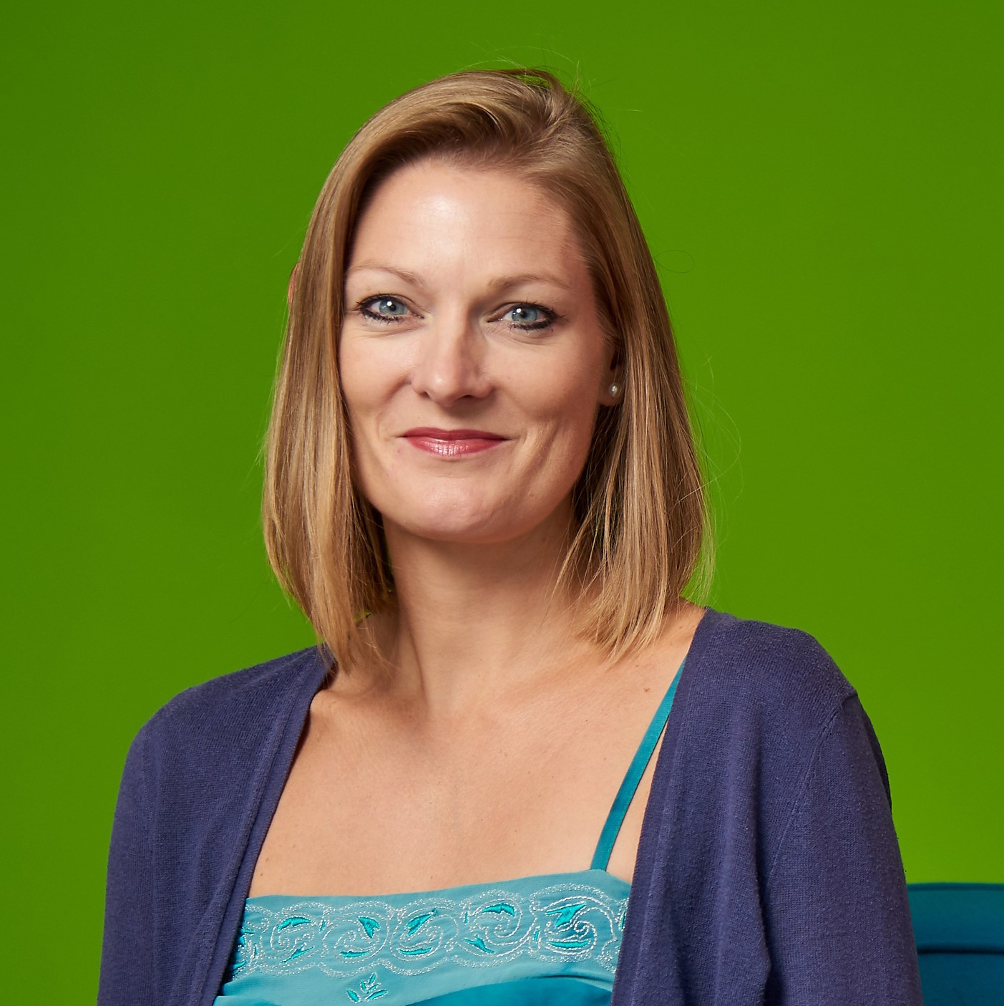
Esther Campsall
Senior Associate
T: 0121 212 7431
E: esther.campsall@anthonycollins.com

Slide 3

WHERE ARE WE GOING TODAY?
What expectations/questions do you have?
We will be looking at:
The structure of churches
The role/legal duties of trustees
Conduct and what we should expect from each other
Update on charity law
Opportunity for questions

Slide 4
WHAT IS YOUR CHURCH?
Charitable unincorporated association
Charitable incorporated organisation
Charitable company
Separate property trusts – church and possibly manse

Slide 5
CHARITABLE
Are we really a charity?
S1 (1) Charities Act 2011
“Charity means an institution which is established for charitable purposes only”

Slide 6
CHARITABLE
Charitable Purposes
What is a “charitable purpose”?
Traditionally four heads:
  relief of poverty
  advancement of education
  advancement of religion
  other purposes beneficial to community

Slide 7
CHARITABLE
Charitable Purposes
What is a “charitable purpose”?
Current position
  a purpose listed in s.3(1) Charities Act 2011; and
  is for the public benefit

Slide 8
CHARITABLE
Charitable Purposes
One of the charitable purposes is
“the advancement of religion”
This is likely to be YOUR principal charitable purpose

Slide 9
CHARITABLE
Objects
May be along the lines of:
The principal purpose of the Church is the advancement of the Christian faith according to the principles of the Baptist denomination. The Church may also advance education and carry out other charitable purposes in the United Kingdom and/or other parts of the world.

Slide 10
CHARITABLE
Charitable Purposes Only
Watch out for “non-charitable trading”

Slide 11
CHARITABLE
Public Benefit
To be a “charitable purpose” it must also be “for the public benefit”:-
identifiable benefit
benefit is to a section of the public:-
  beneficiaries appropriate to the aims
  sufficient section of the public
  people on low incomes not excluded
  private benefit is incidental

Slide 12
CHARITABLE
Registered – to be or not to be!
A charity can only register with the Charity Commission if:
It is set up in England and/or Wales for exclusively charitable purposes
Annual income over £5,000 per annum
Excepted charity because a member of certain denominations e.g. Baptist Union, Church of England, Methodist etc. and has an income over £100,000 (although note now can voluntarily registration)
It is not an exempt charity
ALL CIOs must register!

Slide 13
CONTRAST YOUR STRUCTURE
Unincorporated association/CIO/Company
Legal personality or no legal personality?
Can only act its own name if it is as a corporate structure.

Slide 14
WHAT ABOUT OUR CHURCH BUILDING (AND MANSE)
Possibly held on old trusts
Model trusts
Possibly held by individuals or by a Baptist Trust Corporation (HEBA/BUC etc)

Slide 15
CHARITABLE STATUS
ADVANTAGES
Tax relief
Tax breaks
Funding possibilities
Public perception

Slide 16
CHARITABLE STATUS
DISADVANTAGES
Regulation
Administration
Perceived restrictions on activities

Slide 17
CHARITABLE TRUSTEES
“Charity trustees means the persons having general control and management of the administration of a charity”
Section 177 Charities Act 2011
For your Church they might be the Leadership Team/Elders/Deacons

Slide 18
CHARITABLE TRUSTEES
Contrast: Charity Trustee” & “Holding Trustee”

Slide 19

THE LEGAL DUTIES/RESPONSIBILITIES OF THE TRUSTEES

Slide 20
DUTIES OF TRUSTEES
Fiduciary Duties
Act in food faith (ie act in your charity’s best interests)
Care and skill
Know your governing document – constitution – and act in accordance with it
Act within the scope of delegated authority

Slide 21
DUTIES OF TRUSTEES
Fiduciary Duties
Act personally
Secure the proper and effective use of property

Slide 22
DUTIES OF TRUSTEES
Fiduciary Duties: Act in Good Faith
A Trustee should act in the best interests of the charity and therefore should not put himself/herself in a position where his/her personal interest and his/her duty to the charity conflict.

Slide 23
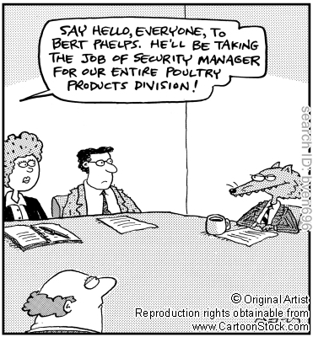
DUTIES OF TRUSTEES: Conflicts of Interest
personal interests & duties
-v-
the charity’s interests & duties
=
conflict

Slide 24
DUTIES OF TRUSTEES:
Conflicts of Interest
stop declare it
look check governing document (constitution)/conflict of interests policy
listen leave meeting if required
think can you vote?

Slide 25
DUTIES OF TRUSTEES:
Fiduciary Duty: Act in Good Faith – Payment of Trustees
General rule is that Trustees (and connected persons) cannot be paid by the charity unless:-
allowed in your governing document;
authorised by statute ie. 185 Charities Act 2011; or
authorised by the Charity Commission

Slide 26
DUTIES OF TRUSTEES:
Fiduciary Duty: Care and Skill
Care and skill – two levels
  Sensible and careful business person
  Specialist knowledge and experience

Slide 27
DUTIES OF TRUSTEES:
Fiduciary Duty: Care and Skill
Regular attendance at and proper preparation for meetings – reading minutes
Raising concerns – check the minutes
Encouraging the Trustees to take professional advice
Ensuring proper arrangements for supervising employees and handling money
Ensuring proper protection of assets – insurance
Policies in place / risk assessments etc.

Slide 28
DUTIES OF TRUSTEES:
Fiduciary Duties: Know your governing document – and act in accordance with it
You need to know the contents!
Objects
Powers
How trustees are appointed/retire
Who can be a member and how a person is accepted into membership

Slide 29
DUTIES OF TRUSTEES:
Fiduciary Duties: Act within the school of delegated authority
Only bind the Church if you have authority to do so – NB the importance of the Church Meeting

Slide 30
DUTIES OF TRUSTEES:
Fiduciary Duties: Act personally
Only you can be you!

Slide 31
DUTIES OF TRUSTEES:
Fiduciary Duties: Secure the proper and effective use of property
Manage the Church’s resources responsibly
Make sure the Church’s assets are only use to support or carry out its purposes
Avoid exposing the Church’s assets, beneficiaries or reputation to undue risk
Don’t over commit the Church
Comply with restrictions on spending funds or selling land

Slide 32
DUTIES OF TRUSTEES:
Statutory Duties
Re insolvency
Not acting when disqualified
To account – SORP
To file information – Charity Commission e.g. Trustees’ Annual Report/Serious Incident Reports
Display information including declaring charitable status on official publications

Slide 33
DUTIES OF TRUSTEES:
Statutory Duties contd.
Maintain records – (statutory books) & minutes
To supply information to the Charity Commission
To apply for a Charity Commission Scheme

Slide 34
CASE STUDIES
Case Study 1
Case Study 2

Slide 35

Duties under the general law
Contractual (e.g. contracts with suppliers)
Tort (e.g. negligence, nuisance)
Employment
Data protection
Health and safety
National Insurance, VAT and other tax
Equality legislation

Slide 36
POTENTIAL LIABILITIES
Civil liability
  to third parties
  to the charity:
  unlimited personal liability for a breach of fiduciary duty resulting in loss to the charity

Slide 37
REASSURANCE
Insurance
Relief granted by the Court
Relief granted by the Charity Commission

Slide 38
TOP TIPS
Regularly attend and prepare for trustee meetings
Contribute to and raise concerns at trustee meetings – ask those awkward questions
Check minutes to ensure they are detailed and accurate and reflect any concerns raised at meetings
Ensure the trustees regularly monitors and reviews its compliance with and performance of its policies
Encourage the trustees to seek and act upon legal, financial and other professional advice whenever necessary

Slide 39
TOP TIPS…
Ensure proper arrangements are in place for handling money
Ensure good reporting procedures are in place
Make sure employees are properly supervised
When signing documents, ensure you are authorised

Slide 40

PERCEPTIONS…

Slide 41
All trustees have a contribution to make and a perspective – its not always about a particular view:
Big picture and detail are both required
One person invariably can’t see it all (& sometimes doesn’t want to!)

Slide 42

WHAT CAN YOU DO?
Be kind
Be clear
“more than a minute is your autobiography”
Be aware of what your body language is giving away
Avoid sarcasm, condescension, or other put downs
Don’t interrupt

Slide 43
WHAT CAN YOU DO?
Expect to have a successful meeting – prepare to succeed
Maintain collective responsibility and protect the reputation of the individuals and the Church
Maintain confidentiality
Supervise but don’t micromanage the employee team – let them do their jobs!

Slide 44
Do your best, and don’t nick the teaspoons…
Trustees and employees must co-operate
to make the governance work
Talk to each other
Listen to each other
Challenge each other
Strive to understand each other

Slide 46
CHARITY LAW UPDATE
Charity Commission updated guidance on
  internal financial controls for charities and protecting against fraud
  protecting charities from cyber crime
  paying a trustee or connected person

Slide 47
CHARITY LAW UPDATE
Tweaks to the Charities Act 2011
The Economic Crime and Corporate Transparency Act 2023 – requirements around verifying the identity of directors and persons with significant control
Employment Rights Bill 2024
New preventative duty to prevent sexual harassment in the workplace

